Slide 1

Tier 2
Secondary Prevention/Supports
Training
Positive Behavior Interventions & Supports

Slide 2
Participants will:
Have an understanding of the interconnectedness between Tier 1 & Tier 2 implementation
Have an understanding of the readiness criteria for Tier 2
Have an understanding of the systems development for the implementation of Tier 2
Have an understanding of how to Evaluate the effectiveness of Tier 2 interventions
Gain insight into tier 3

Slide 3

A quick review of Tier 1
How it all fits together….

Slide 4
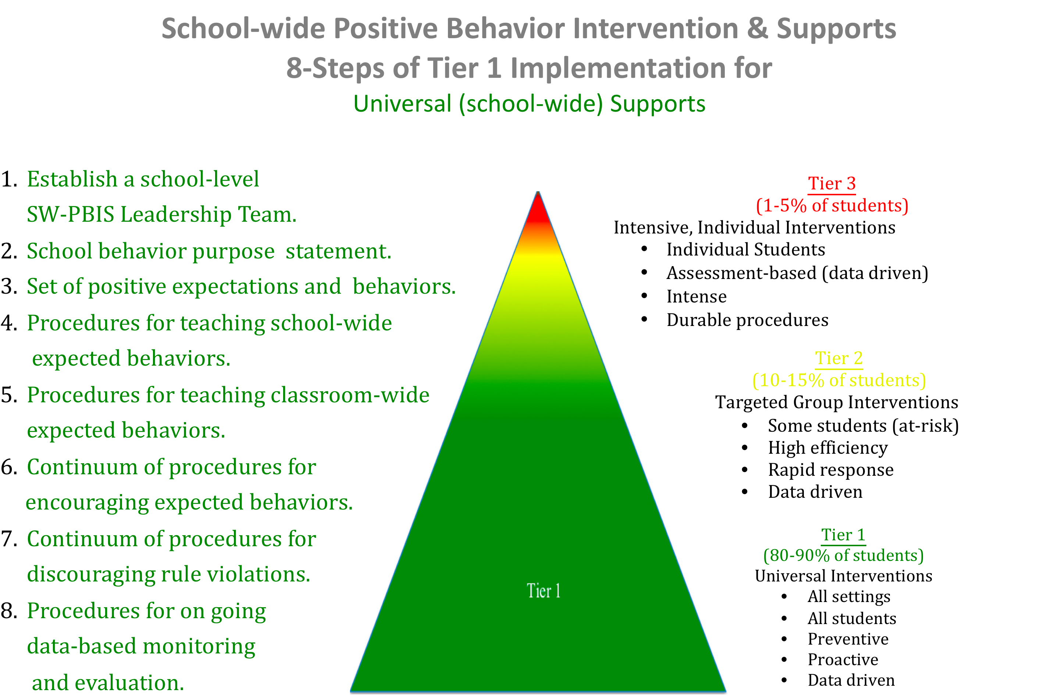

Slide 5
Goal: Social Competence &
Academic Achievement (Tier 1)
Supporting
Student Behavior
Supporting Decision
Making
Student Outcomes
School district policy and procedures, curriculum development, violation system development, data based decision-making process
ODR, Reward system data
Suspension, expulsion, graduation rate, drop out rate, attendance
SYSTEMS
DATA
PRACTICES
Teach non-structured behavior expectations
Implementing positive consequence system
Implement violation system
Evidence-based academic instruction/assessment
Behavioral Health coordination & communication.
Supporting
Staff
Behavior
Adapted from www.pbis.org
Notes:
In general, SWPBS emphasizes four integrated elements: (a) data for decision making, (b) measurable outcomes supported and evaluated by data, (c) practices with evidence that these outcomes are achievable, and (d) systems that efficiently and effectively support implementation of these practices.

Slide 6
Tier 1 is at Fidelity if:
Classrooms are:
Problem Solving
  Reviewing data
  Developing function-based interventions
Schools have:
80% or more on School-wide Evaluation Tool
Data based decision making utilizing Office Discipline Referrals (ODR)
Feedback from parents, visitors, staff
Data collection systems in place
Tier 1 Leadership Teams
  School-wide PBIS
  Universal supports for the 8 steps

Slide 7
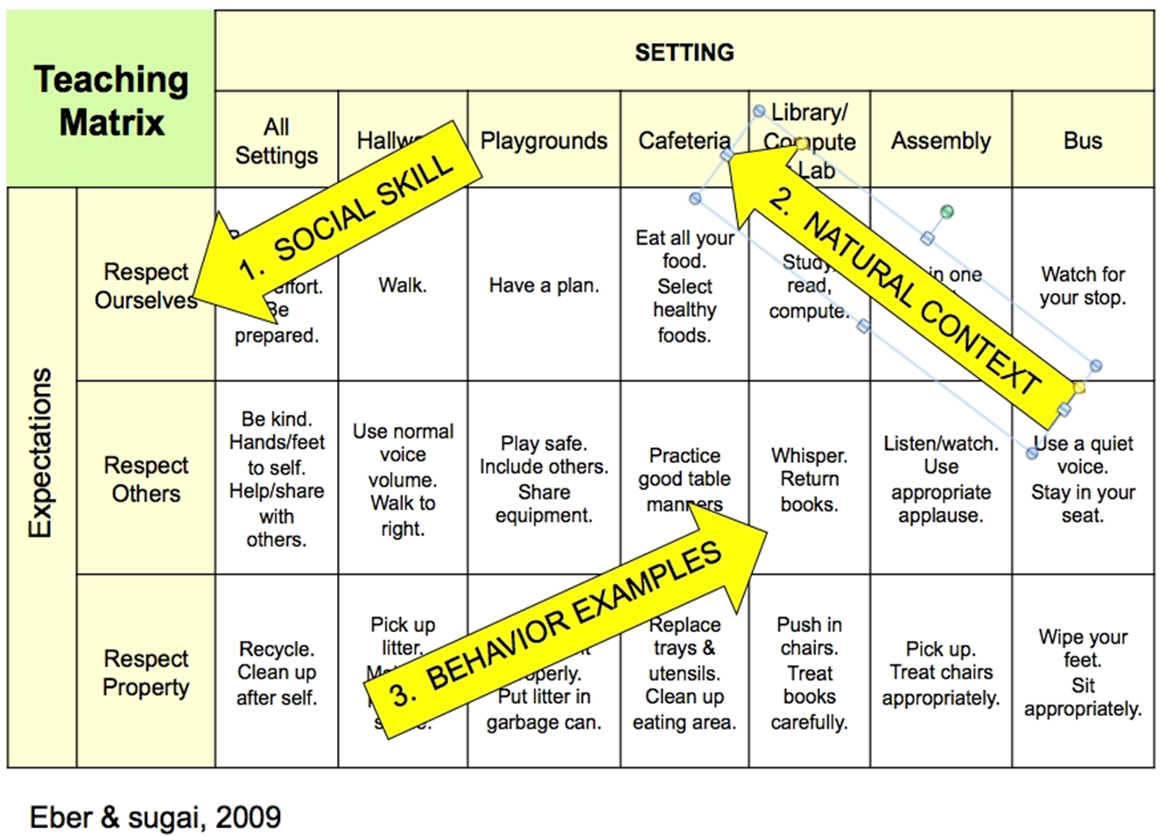

Slide 8
Insert Your Schools Matrix

Slide 9
Designing School-Wide Systems for Student Success
Academic Systems
Behavioral Systems
Intensive, Individual Interventions
Individual Students
Assessment-based
High Intensity
Intensive, Individual Interventions
Individual Students
Assessment-based
Intense, durable procedures
1-5%
1-5%
Targeted Group Interventions
Some students (at-risk)
High efficiency
Rapid response
5-10%
5-10%
Targeted Group Interventions
Some students (at-risk)
High efficiency
Rapid response
Universal Interventions
All students
Preventive, proactive
80-90%
80-90%
Universal Interventions
All settings, all students
Preventive, proactive
www.PBIS.org

Slide 10
Tier 2
Reach fidelity of Tier 1 implementation
Identify data collection methods for Tier 2 interventions
Identify what targeted supports systems need to be developed within the school
Continue to monitor & evaluate school-wide progress
Identify students in need of additional supports based on Tier 1 data
Identify and implement targeted supports
Develop simple & short ways to monitor & evaluate progress
Involve behavioral health agencies, as appropriate

Slide 11
Tier 2 Intervention Readiness
Staff recognize need for implementation of tier 2 system.
Administrative support.
Time & money allocated.
No major changes in school climate:
  Ex. teacher strikes, administrative turnover, major changes in funding
Tier 2 implementation a top priority by grade level teams.

Slide 12
Why Tier 2 Supports
Understand interaction between behavior and the teaching environment
    Behavior is functionally related to the teaching environment
Build Positive Behavior Support Plans that teach pro-social “replacement” behaviors
Create environments to support the use of pro-social behaviors (practice, practice, practice)
  School-wide
  Classroom
  Small Group / Individual

Slide 13
Goal: Social Competence &
Academic Achievement (Tier 2)
Supporting Decision
Making
Student Outcomes
Classroom, school-wide, parent communication, behavioral health & school district collaboration
ODR, intervention, counseling , suspension, detention, BH treatment, attendance, replacement behavior
SYSTEMS
DATA
PRACTICES
Supporting
Staff Behavior
Classroom management, CICO, small groups with counselor/BH, Tier 2 FBA/BSP, organizational skills, behavioral health collaboration
Supporting
Student Behavior

Slide 14
Basic Steps Prior to Tier 2 Supports
Are classroom universals in place
Has the student been identified for classroom support?
Are classroom problem solving strategies in place (ex. Child Study Teams)
  Has the student not responded to classroom / informal supports
  Has the problem implemented a solving plan
  Has the classroom maintained progress monitoring data
Consider for Tier 2 supports.
Based on function of problem behavior and response to classroom supports, match student to Tier 2intervention

Slide 15

Infrastructure Review/ Development
Tier 2 intervention action steps to determine:
  What Tier 2 supports are in place
  Professional development needs
  Internal and external support needs
  Data collection needs for data based decision-making.
  Staffing needs
Parent training/support needed
Behavioral Health MOA and referral process needs

Slide 16
Critical Features
Intervention is continuously available across staff.
Positive interactions built into system of evaluation.
Proactive intervention to prevent problems from occurring.
Rapid access for identified student interventions (less than a week).
Very low effort by teachers.
Positive System of Support.
Students agree to participate.
Implemented by all staff in the school (teacher through librarian).
Flexible intervention based on assessment:
  Brief Functional Assessment
Continuous monitoring for decision-making.
  Tier 2 teams
Transition to self-management.
Student NOT teacher driven targeted interventions.

Slide 17
Challenges to Consider
Teacher
Parents
Student
Train teachers to assist student to evaluate and record
Training/reminders to students
Data collection system
Notification and support from parents for student participation.
Parent role in training student to take responsibility for program.
Parent involvement (daily point sheets, etc).
How else can parents be involved?
Provide training to students to understand and implement plan consistently.
Teach responsible for implementation & parent communication.

Slide 18
What are
Tier 2
Interventions?
Social Skills
Bullying prevention
Anger management
Tier 2
Small Groups
Check In Check Out
Behavior Contract
Classroom Interventions
Behavioral Health Collaboration

Slide 19

Developing Friendship Skills.
Enhancing Emotional Literacy
Identifying Feelings in Self and Others
Controlling Anger and Impulse.
Developing Problem Solving Skills
Targeted Social Skills

Slide 20
Why do Tier 2 interventions work?
Improve structure:
  Provide prompts throughout day.
  Built in rapport with at least 1 adult.
  Student chooses to participate (increases ownership).
  Parent support/involvement.
  Student is “set up” for success.
Increased feedback:
  Feedback occurs often, from many adults, across settings.
  Feedback tied to student behavior.
  Feedback is structured, non-judgmental and linked to targeted skills.
  Feedback is immediate (less chance of missing something)
Evolve to self-management

Slide 21

Who is involved with Tier 2?

Slide 22
Tier 2 Support Team Members
Variety of personnel
  Administrator
  Counselor
  Behavioral health staff
  Parent
  Reading teacher
  Special education
  Individual with behavioral/FBA expertise
  Targeted intervention coor./coach (check-in checkout person)

Slide 23
Tier 2 Team Responsibilities
Primary role
Other roles
Continue to build process
Assist with Team problem solving process
Connect interventions with SW expectations
Monitor overall progress
Review referrals and place students in appropriate Tier 2 interventions
Serve as “coordinators” of tier 2 interventions
Communicate interventions to staff and parents
Monitor student progress

Slide 24

Tier 2 Coordinator/Coach Responsibilities
Identify staff development for implementing interventions
Process referrals for Tier 2
Insure fidelity of intervention implementation
Facilitate, collect & review student data
Schedule student reviews & develop meeting agenda
Manage all aspects of interventions

Slide 25
Characteristics of an effective coordinator/ internal coach
Flexibility within job responsibility (morning and afternoon)
Positive and enthusiastic.
Someone the students enjoy, trust, and will talk to.
Ability to work through daily student issues quickly.
Organized and dependable.
Works at school every day (not itinerant).
Ability to communicate with parents.
“Sell” program to parents and students.

Slide 26

Role of Behavioral Health
Promote interagency collaboration
Provide community and in-home updates
Support home-school communication and support (Tier 2 & 3)
Assist with Agency linkages for student support
Crisis response/ interventions
Participate in behavior planning, if appropriate
Counseling support
Data sharing

Slide 27
Tier II /
Small Group Supports/ Behavior Health
Classroom Supports (essential features)
Student
School-Wide Universal Supports (8 steps)
Continuum of Positive Behavior Supports
www.pbis.org

Slide 28
5 Steps in Implementing Tier 2 Supports
Step 1: Classroom Problem Solving
Step 2: Identify Students in need of Tier 2 supports
Step 3: Teacher referrals for Tier 2 Supports
Step 4: Tier 2 Supports
Step 5: Review plan/ data based decisions

Slide 29

Step 1: Classroom Problem Solving
Schedule weekly or bi-weekly meetings.
Follow the following process
  Provide data for data-based decision making
    Provide a template for guiding questions
  Function-based intervention
    Determine the function of the behavior
    Teach replacement skills for the undesired behavior
    Assess environment and make modifications
  Monitor progress with data
  Review student progress
    Continue plan or modify as needed

Slide 30
Step 2: Identify Students in Need of Tier 2 Supports
Possible methods to identify students:
Universal screening
Academic and behavior data collection
Teacher referral/nomination

Slide 31

Tier 2 Team Process
Determine referral to Tier 2 team:
General education teacher initiates PBIS Tier 2 intervention process by taking it to the Tier 2 team and developing an Action Plan.
  Review of student academic and behavioral data.
  Determine function of behavior.
Determines small group intervention options and data collection techniques.
Implement the student’s action plan.
Evaluate the plan every 4-6 weeks.

Slide 32
Step 3: Teacher Referrals for Tier 2 Supports
What students to refer?
How do you refer?
Students who do not respond to classroom / informal supports
Student brought to Tier II Team
  Classroom problem solving plan
  Progress data
Based on function of problem behavior and response to classroom supports, match student to Tier II intervention
Teacher Nomination
Data review
Other?

Slide 33

Other Strategies to Identify Students
Teacher Referral
  Questions to discuss:
    Who completes
    When
    What data must be used/cited
    Focus on externalizing and internalizing
Screening
  What instrument
  Schedule

Slide 34
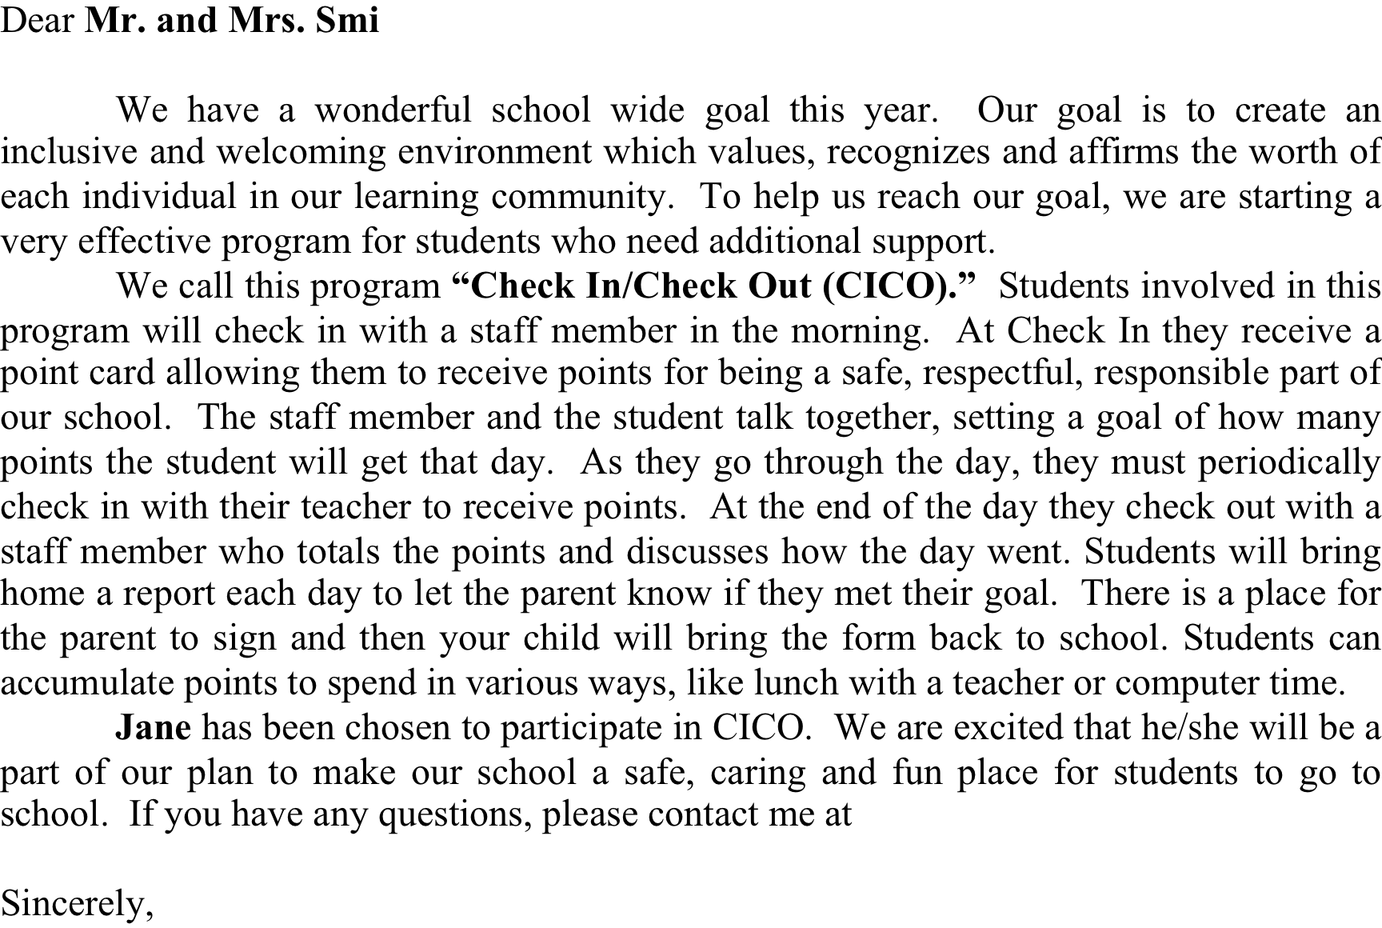
Sample Parent letter

Slide 35

Step 4: Tier 2 Supports

Slide 36
Tier II Supports
Centralized
Each has a coordinator
Placed in support by Tier II Team
Classroom supports continued / modified
ALL in building aware of their role in supporting students in Tier II Supports

Slide 37
Small group targeted interventions
Identify critical skills needed.
Select into group based on ration to life circumstances not existing circumstances (fighting with peers, not family divorce)
Goal for improvement same across all group members.
Data collected and used based on the use of the replacement behavior (skills) in natural settings (not counseling office).
Stakeholders (teacher, family, etc.) have input and role in success of intervention.

Slide 38
What are Tier 2 interventions?
Check in Check Out
Small group targeted supports
  Social skills
  Bully prevention/intervention
  Anger management
  Others?
Behavior contracts
Academic supports
Behavioral Health collaboration
Others?

Slide 39
Development and Implementation Steps
Develop a reinforcement system for students on the BEP
What will students’ daily point goal be?
What reinforcers will students receive for checking in and out (e.g., praise and lottery ticket)?
What reinforcers will students receive for checking out AND meeting their daily point goal?
How will you ensure students do not become satiated on the reinforcers?
How will you keep parents informed?
Consequences for students who receive major & minor referrals

Slide 40
Considerations for Developing a Reward System
Most schools include an opportunity for small daily rewards (note: should always be paired with social praise)
  Snack/candy, sticker, school token, high five
  Reward does not have to be tangible!
Opportunity to earn larger reward
  Points on a credit card
  Stickers on a chart
Examples of Long term rewards:
  Free time: gym, computer, time with friends
  Lunch with preferred adult
  Coupons to snack bar, movie theater, school store

Slide 41

Check In Check Out
Student identification
  School-wide Tier 1 behavior data (SWIS)
  Teacher nomination
Check-in and check out with an adult at school
Regular feedback and reinforcement from adults
Family and behavior health component
Daily performance data used to evaluate progress (data-based decision-making)

Slide 42
Who is Tier 2 Check In Check Out good for?
Appropriate
Low-level problem
Brief Functional Behavior Assessment
Child Study Team decision
Parent support
Behavior (not severe)
  3-7 referrals
Behavior occurs across multiple locations
Examples
  talking out
  minor disruption
  work completion
Inappropriate
Serious or violent behaviors/infractions
In depth Functional Behavior Assessment
Extreme chronic behavior
  8-10+ referrals
Require more individualized support
  Individual Behavior Intervention Plan
Wrap Around Services

Slide 43

Sample Check-in Check-out point sheet

Slide 44

Behavior Contracts
Student name
Target behavior (with replacement behavior)
Goals with criteria for success
Reward of goal met
Consequence if goal not met (if any)
Duration/review of contract date
Staff and student signature
  Parent signature

Slide 45
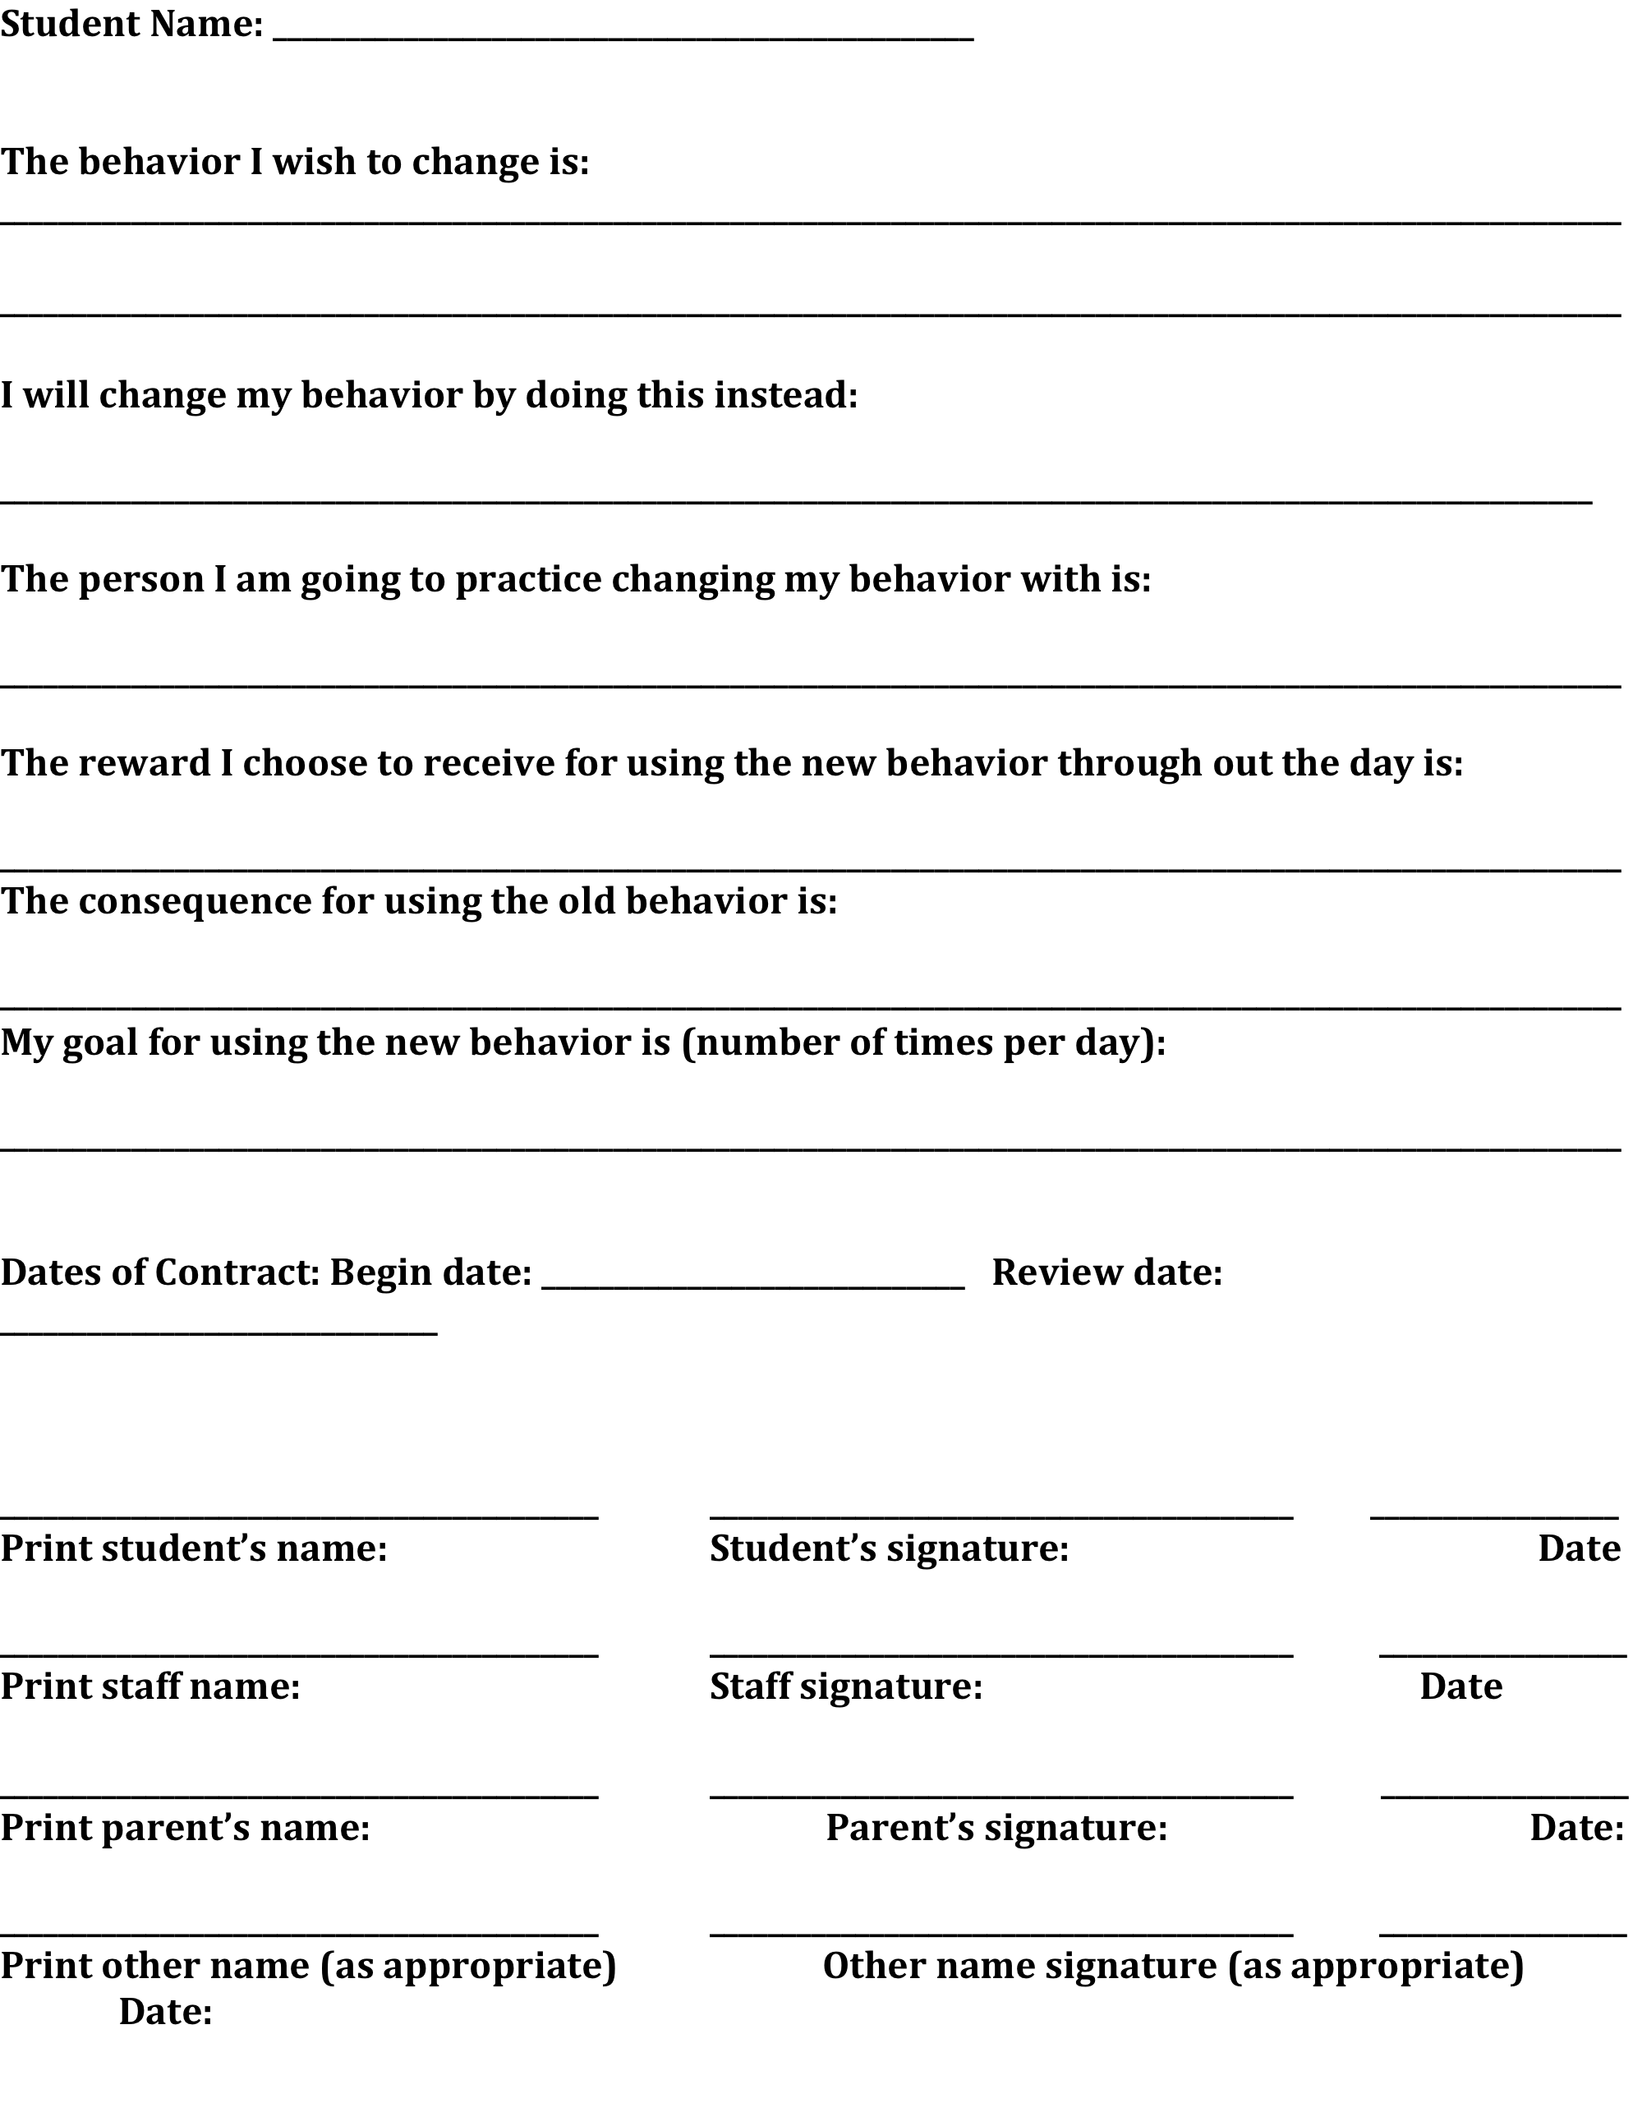
Sample Behavior Contract

Slide 46
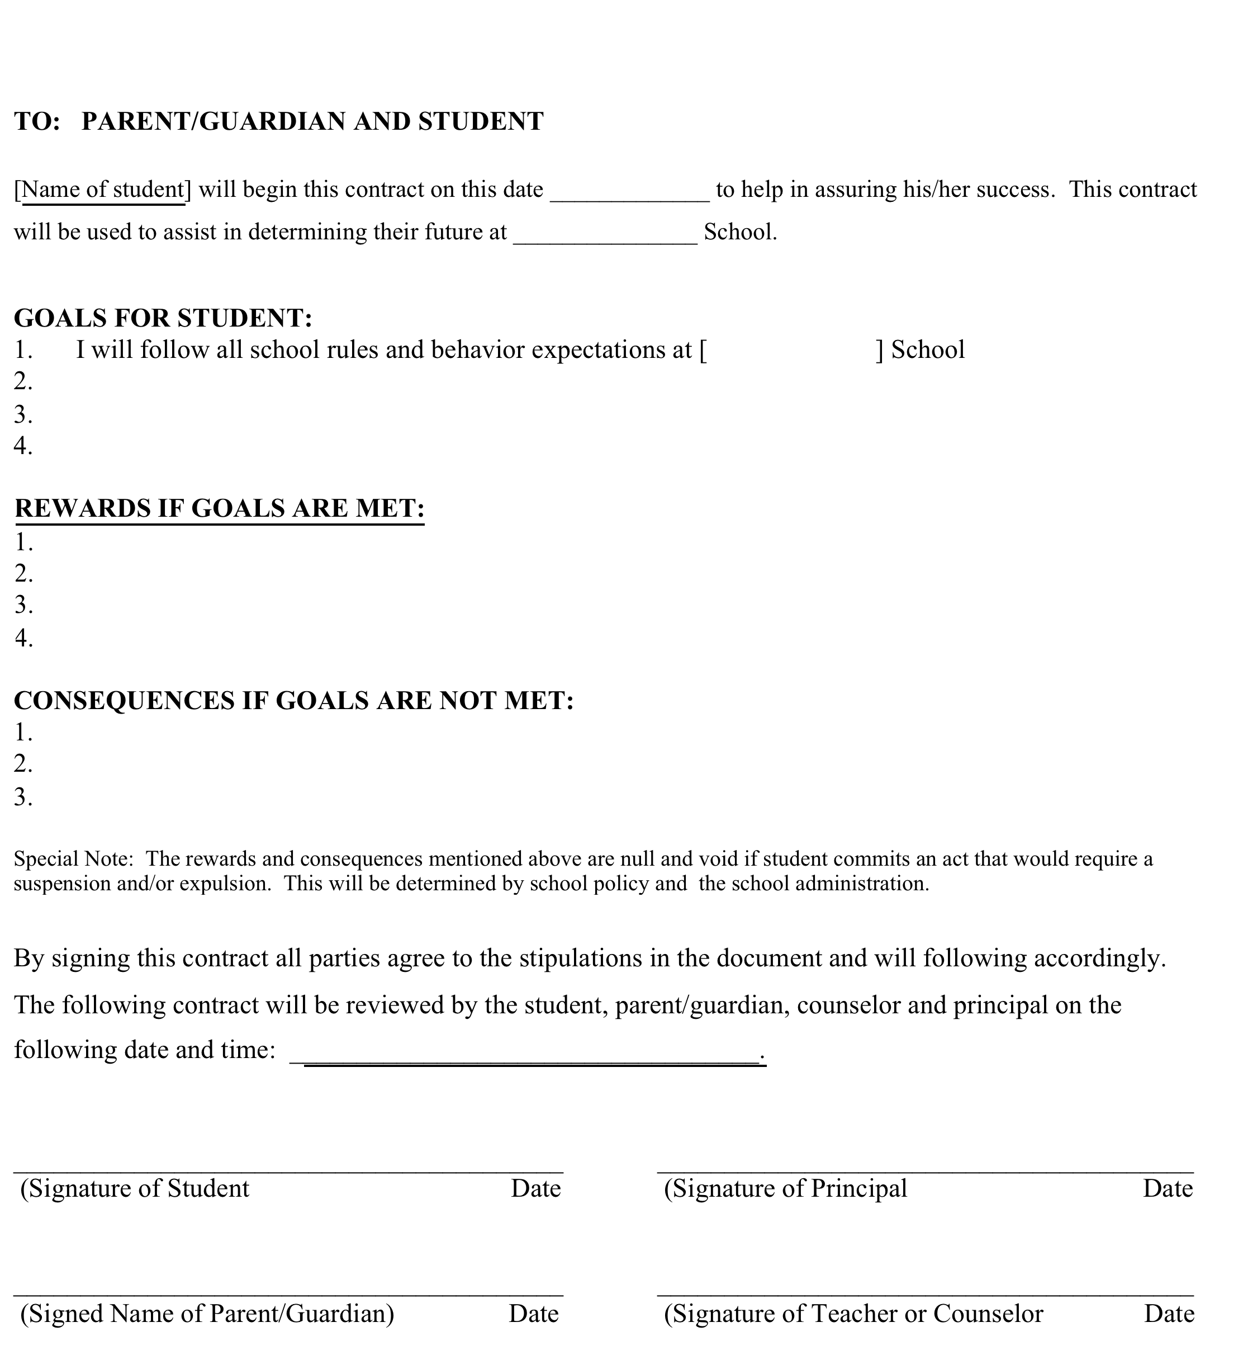
Sample behavior contract

Slide 47
Positive Consequence System (Tier 2)
Based on behavior contract
Small group or individualized
Least intrusive and individualized

Slide 48
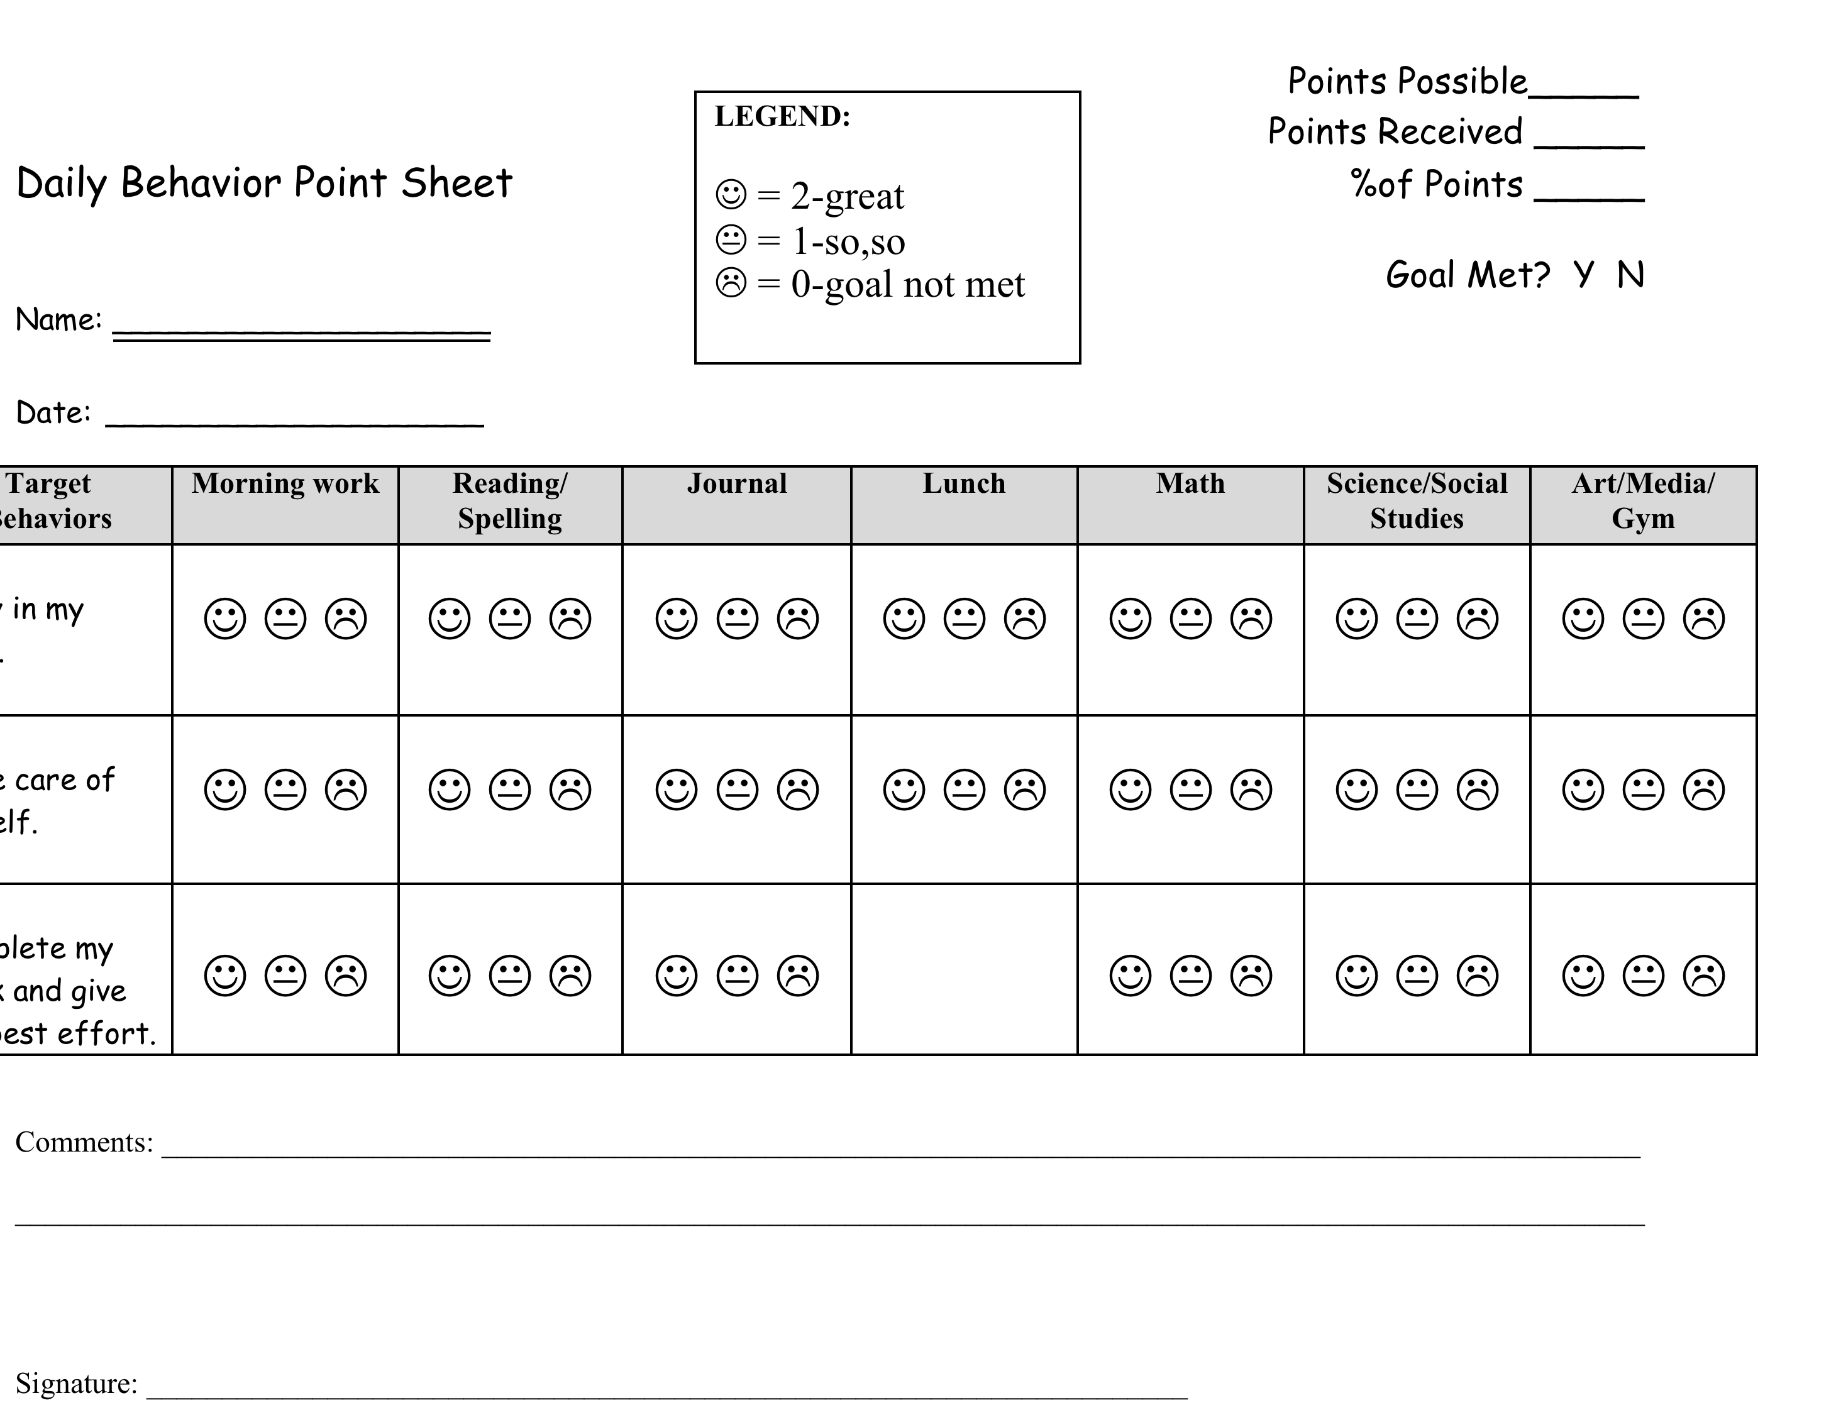
Behavior expectation (matrix)
Daily lesson
1-3 rating for accomplishing goal/expectation

Slide 49
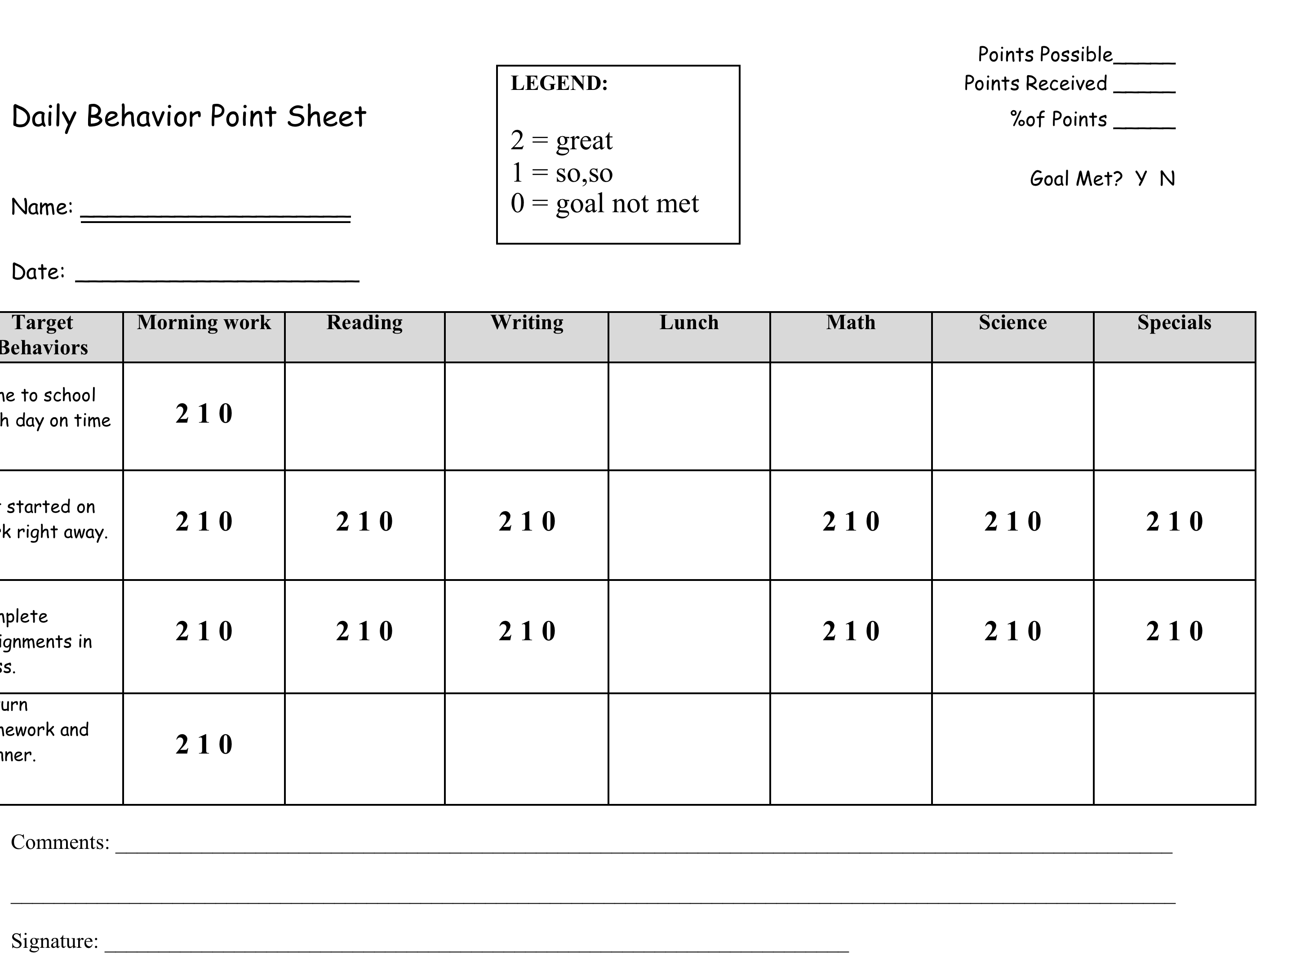

Slide 50
Behavioral Health Collaboration
Structured referral process
Treatment development collaboration
Data sharing for treatment plan writing and review, if appropriate
Part of Tier 2 Targeted intervention team
On going communication (home, school)

Slide 51

Step 5: Review Plan/ Data Based Decisions
Review data by-weekly
Determine need to :
  No progress over time: modify plan
  Lack or minimal progress over time: Modify or maintain plan
  Reach goal: maintain plan
  Reach and maintain goal over time: consider fading out Tier 2 support and returning to Tier 1 level of supports with informal check-in.

Slide 52
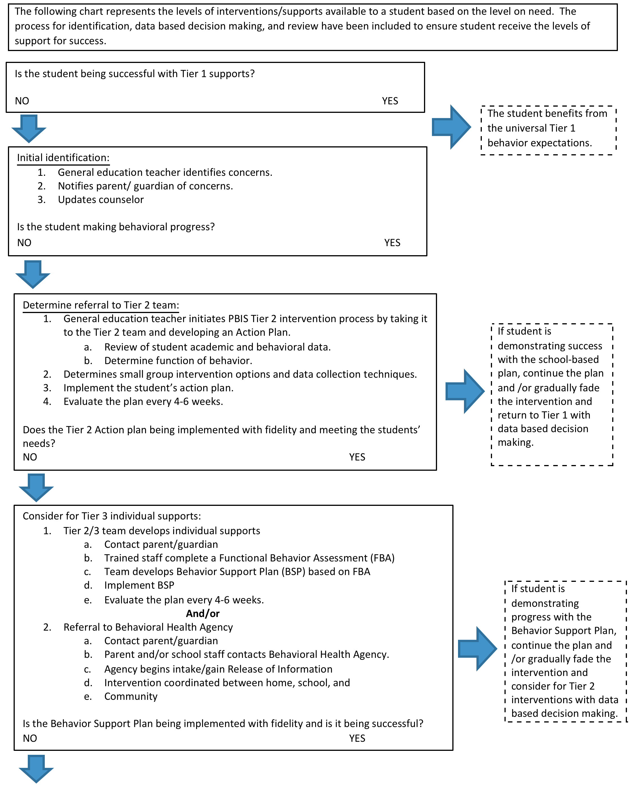

Slide 53
Monitor Student Progress and Evaluate Process
Original data sources that lead to student identification
  ODR
  Attendance
  Academics
  “time out of class”
  Teacher perception
Key = frequent and regular
  Celebrate success
  Adjust if student doesn’t respond (or problems start reappearing)
Cost –Benefit Analysis of overall process

Slide 54
Lessons Learned
Teachers need to consistently implement classroom universals
Problem solving teams may need training on team process and how to collect, analyze and make data decisions
Protect meeting time, use an agenda and keep minutes
Build in time for professional development
New teachers may have no background knowledge regarding this process
It is hard to stick to Tier 2 data rules and not “jump” to Tier 3
Teachers often see “Support” as Outside Classroom
Communication, communication, communication!

Slide 55
Now to Work….
How will tier 2 look like in your school?
Who will be the tier 2 Coordinator or Coordinators??
Where will daily check-in and check-out occur?
What is the maximum number of students that can be served on the check in check out at one time?
What is the name of BEP for your and what is the Daily Progress Report called? (optional)
Who will check students in and out when coordinator is absent?

Slide 56
3 Tier System of Support Responsibilities
Tier 1 Leadership Team
Tier 2 Teams
Use process data: determine overall intervention effectiveness
Tier 3 Team
Implement SW & Classroom wide Supports
Uses process data: Determines overall intervention effectiveness
Check In Check Out
Small Group
FBA/BIP
Tier 1/ Universal Support
WRAP Around Services
FBA/BSP

