Slide 1

SW-PBS District Administration Team Orientation
Notes:
This presentation is meant to be used with District and school level administrative staff. It represents the fundamental commitment necessary for the successful implementation of PBIS to reach fidelity of implementation.

Slide 2
School Supports
Family/ Community
Behavioral Health
Positive School Climate / Culture
*developed by EED in collaboration with HSSDBH
Notes:
The Goal of this slide is to get the audience thinking of all of the entities that should be considered when planning for a successful implementation of a positive school climate/ culture.

Slide 3
Academics
Home
Cultural
Social Emotional
Student
Success
*developed by EED in collaboration with HSSDBH
Notes:
The goal of this slide is to show the connection of the roles from the previous slides (slide 2) entities and how they contribute to student success.

Slide 4
Visibility
Funding
Political Support
District Leadership Team
State Support
Active Communication
School Leadership Team
Training
Data/
Evaluation
Coaching
Notes:
The goal of this slide is to show all of the levels of interaction and support that is needed for adoption.

Slide 5
Stages of Implementation
2-3 yrs
Exploration/Adoption
Installation
Development Commitment
Initial Implementation
Establish Leadership Teams, Set Up Data Systems
Full Implementation
Provide Significant Support to Implementers
Innovation and Sustainability
Embedding within Standard Practice
Improvements: Increase Efficiency and Effectiveness
Should we do it?
Doing it right
Doing it better
www.pbis.org
Notes:
The goal of this slide is:
Follow basic logic, but use resources and tools to accomplish what you would like to achieve
Continue to self-evaluate
Continue to keep key stake holders involved (Parents, School Board, Staff, etc. )

Slide 6
Eight steps to Tier One Implementation
Establish a school-level SW-PBS Leadership Team.
School-behavior purpose statement.
Set of positive expectations and behaviors.
Procedures for teaching school-wide expected behaviors.
Procedures for teaching classroom wide expected behaviors.
Continuum of procedures for encouraging expected behaviors.
Continuum of procedures for discouraging rule violations.
Procedures for on-going data-based monitoring and evaluation.
www.pbis.org
Notes:
The goal of this slide is to introduce the admin team to what will be needed to be done to implement Tier 1 to fidelity.

Slide 7
Social Competence &
Academic Achievement
What does SW-PBS
Emphasize?
OUTCOMES
Supporting
Decision
Making
Supporting
Staff Behavior
SYSTEMS
DATA
PRACTICES
Supporting
Student Behavior
www.pbis.org
Notes:
The goal of this slide is to explain that:
SWPBS emphasizes four integrated elements: (a) data for decision making, (b) measurable outcomes supported and evaluated by data, (c) practices with evidence that these outcomes are achievable, and (d) systems that efficiently and effectively support implementation of these practices.

Slide 8
Individualized Supports
Tertiary Prevention:
Specialized
Individualized
Systems for Students with High-Risk Behavior
~5%
Early Identification/ Referral
~15%
Secondary Prevention:
Specialized Group
Systems for Students with At-Risk Behavior
Primary Prevention:
School-/Classroom-
Wide Systems for
All Students,
Staff, & Settings
Leadership/
Support Behavioral Expectations
~80% of Students
Readiness
School Infrastructure
Infrastructure Development
Adapted for EED from PBIS.org
Notes:
The Goal of this slide is to explain the three Tiers of implementation with an emphasis on readiness and school infrastructure.

Slide 9
Diagnostic
Individualized supports
Screening
Evidence-Based Practices
Small group
Social skills
Data based decision making
Substance abuse
Bullying
Suicide prevention
Teen dating violence
Risky sexual behaviors
Domestic violence
Trauma
Academic Supports
School-wide behavior supports
Types of Supports/ Services by Tier
Notes:
The Goal of this slide is to give examples of supports/services that could be done in each tier.

Slide 10
Leadership teams
District
School
Responsible for district wide commitments and SW-PBS planning
School Administrative Team must be committed to SW-PBS and actively participate on the team
Responsible for student and building wide SW-PBS planning and implementation
SW-PBS school leadership team should remain small (3-8 members)
Consider representatives that include: administration, general education teachers, special education teachers, guidance, specials teachers, parents…
Ongoing Communication
Notes:
The Goal of this slide is to distinguish between the roles of the two teams that need to be in place.

Slide 11
Administration’s Roles and Responsibilities
ALL administrators are encouraged to participate in the process.
Administrator should play an active role in the school-wide SW-PBS change process.
Administrators should actively communicate their commitment to the process.
Administrator should be familiar with school’s current data and reporting system.
If a principal is not committed to the change process, it is unwise to move forward in the process.
Notes:
The goal of this slide is to:
Encourage administrators to participate on the school-based and district PBIS Team.
If the administrator is not involved with the team or committed to the change process, it is unwise to attempt to go further with developing the PBIS school-wide plan.

Slide 12

SW-PBS Performance Measures

Slide 13
Allocated Time
(school day)
Support
Time
Student
Time
Engaged Time
(classroom time)
Academic
Engaged
Time
adapted from www.pbisassessment.org
Notes:
The goal of this slide is to point out that academic engaged time is the smallest amount of time, but it is the time when there are the least amount of behaviors.

Slide 14
Our Goal:
Decision-Making System
What do you want the data to tell you?
  School-wide interventions
  Individual student interventions
Adapted from www.swis.org
Notes:
The goal of this slide is to show the process for data based decision making and action planning.

Slide 15
Decision making questions to consider
Is there a problem?
What areas/systems are involved?
Are there many students or few involved?
What kind of problem behaviors are occurring?
When are these behaviors most likely?
What is the most effective use of our resources to address the problem?
Possible “function” of problem behavior?
Who needs targeted or intensive academic supports?
What environmental changes/supports are needed?
Adapted from pbis.org and swis.org
Notes:
The goal of this slide is to represent questions that should be used when analyzing data for data based decision making.

Slide 16
Behavior Data Points
School-wide data
Student specific
Academic Proficiency
Suspension/Expulsion/ truancy
Graduation rates
Drop-out rates
Attendance
Child support data
Teacher/Behavior Associate retention rate
Office discipline Referral
  Major data points
  Student name
  Date
  Location of behavior
  Time of behavior
  Type of behavior
  Referring staff member
  Possible motivation
  Others involved
  Administrative decision
Adapted from pbis.org and swis.org
Notes:
The goal of this slide is to data points to be collected for data based decision making.

Slide 17
Sample Decision Rules
If……… | Then
More than 35% of students received one or more office discipline referrals There are more than 2.5 office discipline referrals per student | School-wide System
More than 35% of referrals come from non-classroom settings There are more than 15% of students receiving referrals from non-classroom settings | Non-Classroom Setting Specific System
More than 50% of referrals come from the classroom More than 40% of referrals come from less than 10% of classrooms | Classroom System
More than 10-15 students receive more than 10 office discipline referrals | Targeted Group Interventions
Less than 10 students receive more than 10 office discipline referrals Less than 10 students continue the same rate of referrals after receiving targeted group support A small number of students destabilize the overall functioning of school | Individual Systems with Action Team Structure
www.pbis.org

Slide 18
Benefits to school systems over time
Administrative Benefit
Springfield MS, MD
= 955 42% improvement
= 14,325 min. @15 min.
= 238.75 hours
= 40 days Administrative time
  2001-2002 2277
  2002-2003 1322
Instructional Benefit
Springfield MS, MD
= 955 42% improvement
= 42,975 min. @ 45 min.
= 716.25 hrs.
= 119 days Instructional
time
  2001-2002 2277
  2002-2003 1322
Notes:
The goal of this slide is to show the time benefit to implementing PBIS.

Slide 19
How are we making the data connection?
Research sample school
Less than 5% of students need individualized supports (6+ ODR)
Tier 3
2%
3 students with 6 or more ODR’s (2%)
Less than 20% need secondary supports (2-5 ODR)
Tier 2
11%
15 students with 2-5 ODR’s (11%)
80% of students respond to school wide universal supports (0-1 ODR)
Tier 1
80%
109 students with 0-1 ODR (80%)
Notes:
The goal of this slide is to show where the office discipline referrals fit within the triangle.

Slide 20
How do we bring it together?
School Intervention by Tier
Academic Interventions | Behavior Interventions
Individualized Interventions/contracts
Response to Instruction
Small group interventions
Student Leadership Team
Responsible Thinking Practices/Classroom
Reward System (partially in place)
Discipline system
School Store
School Wide PBIS Assessments (action planning)
Notes:
The goal of this slide is to assist schools in determining where there system wide interventions support PBIS interventions.

Slide 21
Tools to help….. pbisassessment.org

Slide 22
The School-wide Assessment Survey (SAS)
Measures the perspective from staff for schools to identify the status and priority for improvement in (4) four areas. Responses should be 100% across all areas if Tier 1 PBIS is being implemented with fidelity.

Slide 23
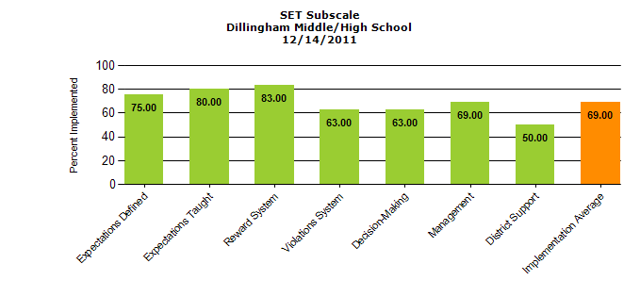
The School-wide Evaluation Tool (SET)
This research tool is designed to measure the critical features of PBIS annually through verbal interview with an administrator, a small number of students, and building staff by the SET evaluator. The SET measures the fidelity of implementation of the Tier 1 interventions based on the verbal responses.

Slide 24
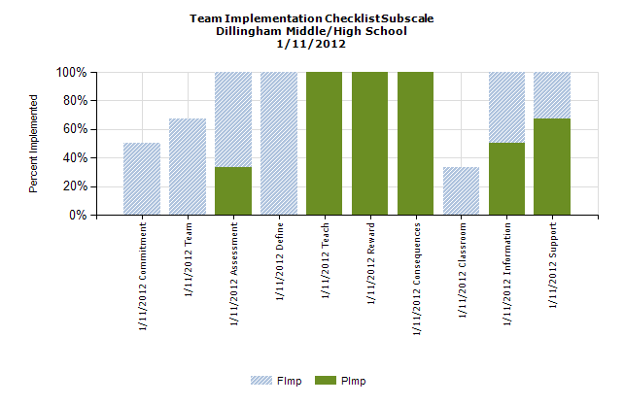
Team Implementation Checklist (TIC)
Is a monitoring tool for school teams implementing SW-PBS. Completed by the Leadership Team to self-evaluate their effectiveness and goal preparation. Completed three to four times a year.

Slide 25
School Safety Survey (SSS)
This survey is to be completed by the SW-PBS coaches through an interview format. The survey is conducted annually and is used to access and identify Risk and Protection Factors for the school.

Slide 26
Challenges
Bullying
Suicide
Substance Abuse
Homelessness
Job Skills
Cultural Diversity
Depression
Support
Health
Supportive Relationships
Violence
Family Violence
Notes:
The goal of this slide is to remind people of all the challenges students face in their day to day lives.

Slide 27
Summary
Investing in SW-PBS results in:
Change in school discipline systems creates an environment that promotes appropriate behavior
Reduction in problem behavior resulting in less staff time dealing with problems, more student time in the classroom
Improved perception of school safety, mental health
Improved academic performance
Improved social behavior performance
Improved effectiveness and acceptability of individual interventions

Slide 28
Is anyone better off??
School
Family
Behavioral Health Agency
Student
Notes:
Question to ponder

