Slide 1
Initial Leadership Team Development Training
Your School Name Here

Slide 2
What will we accomplish today?
Quick review of SW-PBS basics.
Establish common goals and understanding of Leadership Team.
Define roles & responsibilities school teams.
Discuss the organizational format for the Leadership Team.

Slide 3
Stages of Implementation
2-3 yrs
Exploration/ Adoption
Installation
Development Commitment
Initial Implementation
Establish Leadership Teams, Set Up Data Systems
Full Implementation
Provide Significant Support to Implementers
Innovation and Sustainability
Embedding within Standard Practice
Improvements: Increase Efficiency and Effectiveness
We are here!
Adapted from www.pbis.org

Slide 4

Implementation “8 Steps” for Tier 1: Universal Strategies
Establish a school-level SW-PBS Leadership Team.
School-behavior purpose statement.
Set of positive expectations and behaviors.
Procedures for teaching school-wide expected behaviors.
Procedures for teaching classroom wide expected behaviors.
Continuum of procedures for encouraging expected behaviors.
Continuum of procedures for discouraging rule violations.
Procedures for on-going data-based monitoring and evaluation.

Slide 5
Where are you in implementation process?
Adapted from Fixsen & Blase, 2005
You are here!
EXPLORATION & ADOPTION
INSTALLATION
INITIAL IMPLEMENTATION
FULL IMPLEMENTATION
SUSTAINABILITY & SCALABILITY
We think we know what we need, so we ordered 3 month free trial
Let’s make sure we’re ready to implement
Let’s give it a try & evaluate
That worked, let’s do it for real
Let’s make it our way of doing business

Slide 6
Basics of Tier 1 SW-PBS
Developing a school wide social skills curriculum

Slide 7
Visibility
Funding
Political Support
District Leadership Team
Active Communication
School Leadership Team
Training
Data/
Evaluation
Coaching

Slide 8
Tertiary Prevention:
Specialized
Individualized
Systems for Students with High-Risk Behavior
CONTINUUM OF
SCHOOL-WIDE
INSTRUCTIONAL &
POSITIVE BEHAVIOR
SUPPORT
~5%
Secondary Prevention:
Specialized Group
Systems for Students with At-Risk Behavior
~15%
Primary Prevention:
School-/Classroom-
Wide Systems for
All Students,
Staff, & Settings
We are here
~80% of Students
Adapted from www.pbis.org

Slide 9
OUTCOMES
DATA
Clear definitions
Efficient procedures
Easy input/output
Readable displays
Regular review
SYSTEMS
DATA
PRACTICES

Slide 10
OUTCOMES
PRACTICES
Evidence-based
Outcome linked
Cultural/contextual adjustments
Integrated w/ similar initiatives
Doable
SYSTEMS
DATA
PRACTICES

Slide 11
SYSTEMS
Training to fluency
Continuous evaluation
Team-based action planning
Regular relevant reinforcers for staff behavior
Integrated initiatives
OUTCOMES
SYSTEMS
DATA
PRACTICES

Slide 12
OUTCOMES
Data-based
Relevant/valued
Measurable
OUTCOMES
SYSTEMS
DATA
PRACTICES

Slide 13
Why SW-PBS?
Decrease development of new problem behaviors.
Prevent worsening of existing problem behaviors (major and minor).
Redesign learning/teaching environments to eliminate triggers & maintainers of problem behaviors.
Teach, monitor, & acknowledge pro social behavior.
Adapted from pbis.org

Slide 14
The beginning of a unified approach to collecting data, teaching behavior expectations, and implementing the reward systems.
Common Language
MEMBERSHIP
Common Experience
Common Vision/Values

Slide 15
Main Messages
STUDENT ACHIEVEMENT
Good Teaching
Behavior Management
Notes:
Basis is applied behavior analysis.
Change the antecedent or consequence and you can change the behavior.

Slide 16
What does an effective SW-PBS Initiative look like?
>80% of students can tell you what is expected of them & give behavioral example because they have been taught, actively supervised, practiced, & acknowledged.
Positive adult-to-student interactions exceed negative.
Function based behavior support is foundation for addressing problem behavior.
Data- & team-based action planning & implementation are operating.
Administrators are active participants.
Full continuum of behavior support is available to all students.
Common language among students, staff, community, and family.
Sustained as part of the school culture.
Adapted form www.pbis.org

Slide 17
What do we need to do to get there?
Work as school-wide leadership team.
Begin by reviewing current behavioral data.
Link all activities to measurable action plan outcomes & objectives.
Use “effectiveness, efficiency, & relevance” to judge whether activity can be implemented w/ accuracy & sustained.
Use, review, & update action plan at monthly team meetings.
Plan activities 12 months out.
Adapted from www.pbis.org

Slide 18
Phases of Learning
White & Haring, 1980
You are here!
Acquisition
New skill w/ accuracy
Fluency
Speed & consistency
Maintenance
Sustained w/ accuracy & fluency
Practice w/ less feedback
Show, model, explain w/ feedback
Practice w/ feedback
Generalization
Use in new context
Adaptation
Modify & fit behavior in new context
Teach variations w/ feedback
Teach, practice in variety of conditions

Slide 19

Insert your school matrix here!

Slide 20
Designing School-Wide Systems for Student Success
Academic Systems
Behavioral Systems
Intensive, Individual Interventions
Individual Students
Assessment-based
High Intensity
Intensive, Individual Interventions
Individual Students
Assessment-based
Intense, durable procedures
1-5%
1-5%
Targeted Group Interventions
Some students (at-risk)
High efficiency
Rapid response
5-10%
5-10%
Targeted Group Interventions
Some students (at-risk)
High efficiency
Rapid response
Universal Interventions
All students
Preventive, proactive
80-90%
80-90%
Universal Interventions
All settings, all students
Preventive, proactive

Slide 21
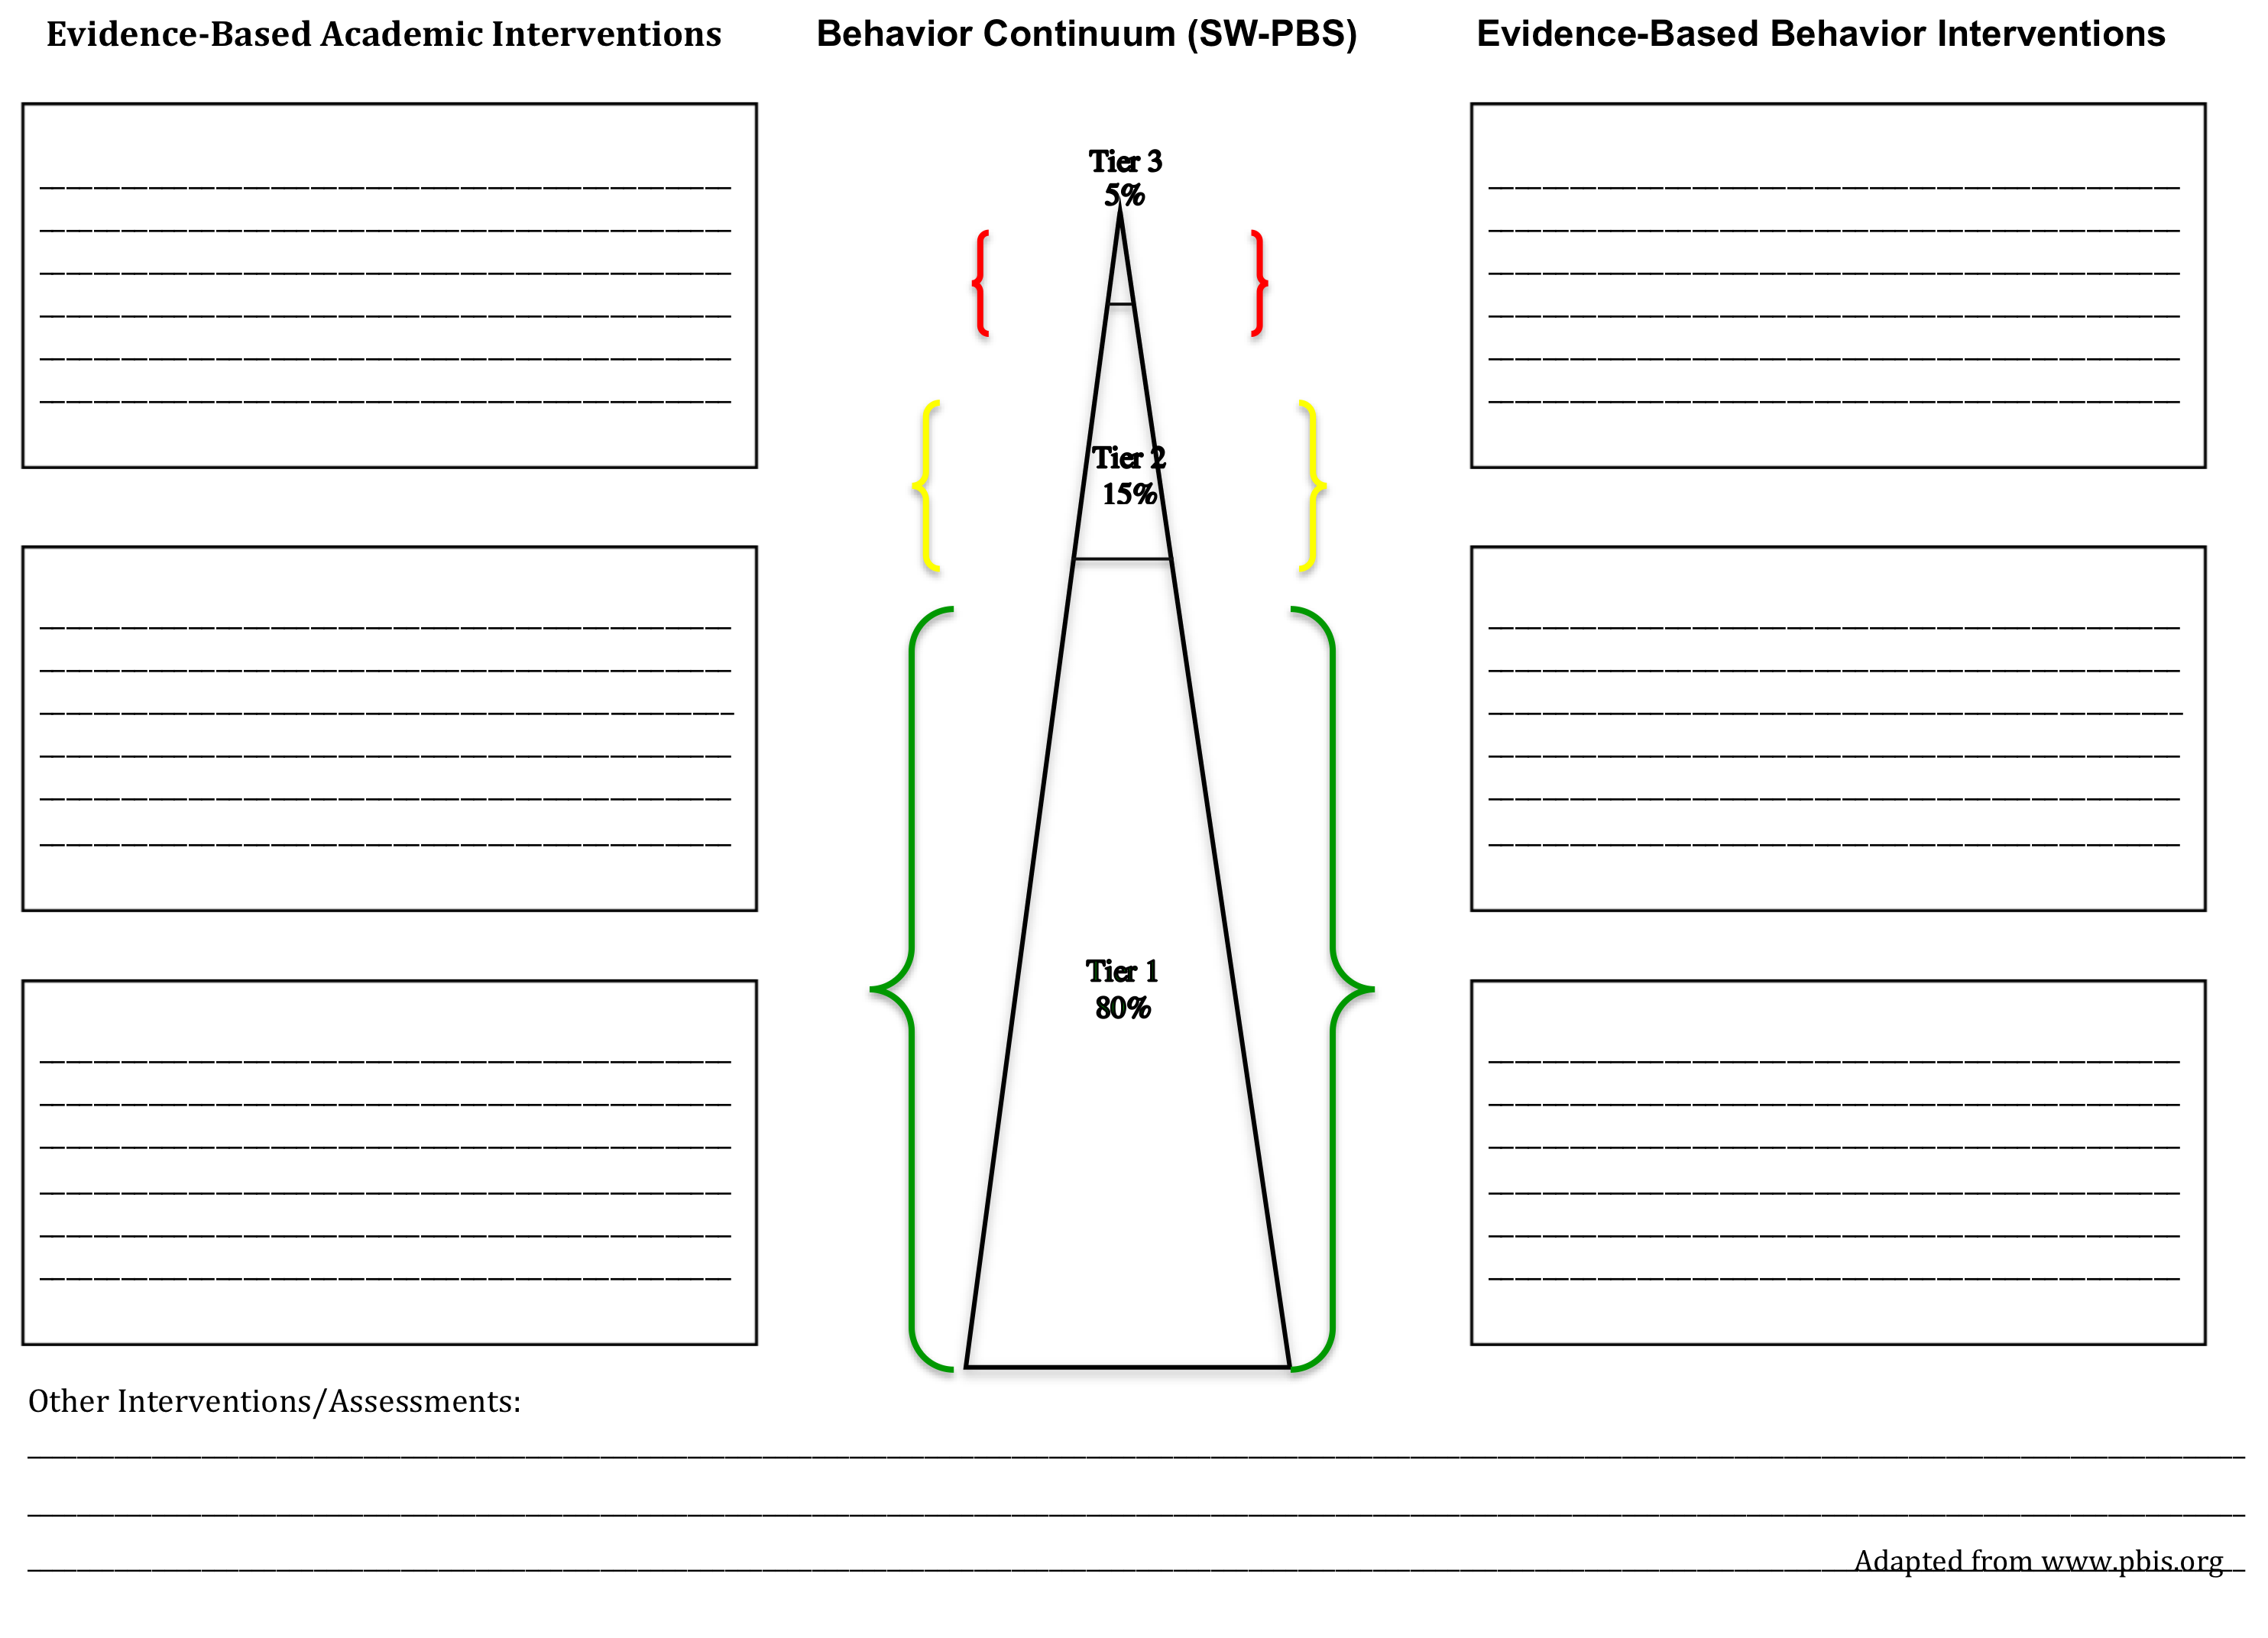

Slide 22
Activity
Complete a “SW-PBS Evidence Based Interventions by Tier” of evidence-based practices
Notes:
In LT notebook

Slide 23
Understanding School System Infrastructure
Defining the teams.

Slide 24
?
?
Notes:
See LT manual for internal/external coach description.

Slide 25
Activity
Group Activity #1: list members of Administrative Leadership Team on sheet provided
Group Activity #2: Define:
  SW-PBS Leadership Team
  Grade level staff team roles & responsibilities
  Student teams
Group Activity #3: List what other school or community groups should be included (present or future)

Slide 26
Organization of meetings
Guidelines to running an effective meeting

Slide 27

parent
Non-Teaching
Specialized Support
Administrator
Community
Student
Teaching
Teaching
Behavioral Health Agency
Start with
Team that
“Works.”

Slide 28
School SW-PBS Team Responsibilities
Develop the school-wide SW-PBS implementation plan (1-2 years).
Monitor behavior data.
Maintain communication with staff and coach.
Evaluate progress of action plans and report outcomes.
Make recommendations for student and staff training.
Make recommendations regarding funding needs and professional development needs.
Articulates through a school-wide common language the expected student and staff behaviors.
Collaborates with the entire staff to plan and implement SW-PBS.
Newton, J.S., Todd, A. W., Horner, R.H., Algozzine, B., & Algozzine K., 2010

Slide 29
1-2 year implementation plan
school
community
Timeline for data collection.
Professional development.
  Local and outside
Refresher for all staff.
Update lesson plans.
Re-teach students behavior matrix.
Reteach students/staff violation system.
Review/revise student positive consequence systems.
Funding sources.
Leadership team member changes
Academic and behavior data.
Staff appreciation.
Connecting with behavior health agencies for tier 2 & 3 support.
Connecting and educating parents about SW-PBS.
Matrix in non-school but school utilized areas.
School networking.
Board updates, etc.
Community appreciation.
Notes:
Review everything beginning of year for appropriateness.

Slide 30
SW-PBS Leadership Team Meets Frequently
Team should meet at least once a month to:
  Analyze real time behavior and academic data.
  Review effectiveness of the existing data/database.
  Problem-solve solutions to critical issues.
  Begin to formulate action plans.
  Promote communication among staff.
Establish collaborative teaming approach.
During initial planning and implementation of Universal Supports, teams may need to meet more often.
Adapted from Newton, J.S., Todd, A. W., Horner, R.H., Algozzine, B., & Algozzine K., 2010
Notes:
Data should be entered at least 1 time per week by identified data person.
Determine who will generate reports for leadership team(electronic or paper).

Slide 31
The Flow of the Meeting
Attendance, roles for meeting.
Review agenda for meeting.
Review/status update of previous meeting minutes.
Review data & problem solving to prompt the development of a comprehensive action plan.
Assign tasks for next meeting with due dates and person responsible.
Team evaluation of meeting.
Storage and dissemination of meeting minutes.
Next meeting scheduled.
Newton, J.S., Todd, A. W., Horner, R.H., Algozzine, B., & Algozzine K., 2010

Slide 32
Suggested agenda items
Review/updates from previous action plan.
SW-PBS update of “8 steps” for Tier 1.
Data review/analysis (see section --- of Leadership Manual)
Data discussion (is there a problem)
Action planning
  Implementation process
  Student need
lroth2012

Slide 33
What makes a successful meeting?
Start & end on time.
75% of team members present & engaged in topic(s).
Agenda is used to guide meeting topics.
System is used for monitoring progress of implemented solutions (review previous meeting minutes).
System is used for documenting decisions.
Facilitator, Minute Taker & Data Analyst come prepared for meeting & complete during the meeting responsibilities.
Next meeting is scheduled.
All regular team members (absent or present) get access to the meeting minutes w/n 24 hours of the meeting.
Decision makers are present when needed.
Efforts are making a difference.
Newton, J.S., Todd, A. W., Horner, R.H., Algozzine, B., & Algozzine K., 2010
Notes:
Schedule the generation of data reports. ODR’s should be turned in and entered.

Slide 34
Other things to Consider for Reaching Fidelity of Tier 1

Slide 35
Sustaining SW-PBS
Teaching New Staff Members.
  Who is responsible for training new staff throughout the year?
Means of instruction
  Person-to-person
  Written guide
  Observations
  Video
Booster Trainings
Preventing Potential Problems (proactive planning)
To be considered in long term SW- PBS action plan writing.
Newton, J.S., Todd, A. W., Horner, R.H., Algozzine, B., & Algozzine K., 2010
Notes:
New staff & students
Beginning of the school year and near holidays/breaks
Based on data

Slide 36
SW-PBS and Cultural Responsiveness
Group Activity: What does this look like in your school?
To be considered in long term SW-PBS action plan writing.
Notes:
Large Russian and Puerto Rican influx.

Slide 37
SW-PBS and Technology
Group Activity: What does this look like in your school?
Web site
Distance support
Data storage
To be considered in long term SW-PBS action plan writing.

Slide 38
Tips for an Effective Meeting

Slide 39
Activity:
Group Activity: list members of Leadership Team on sheet provided:
  Determine dates and location of meetings
  Define roles & responsibilities

Slide 40
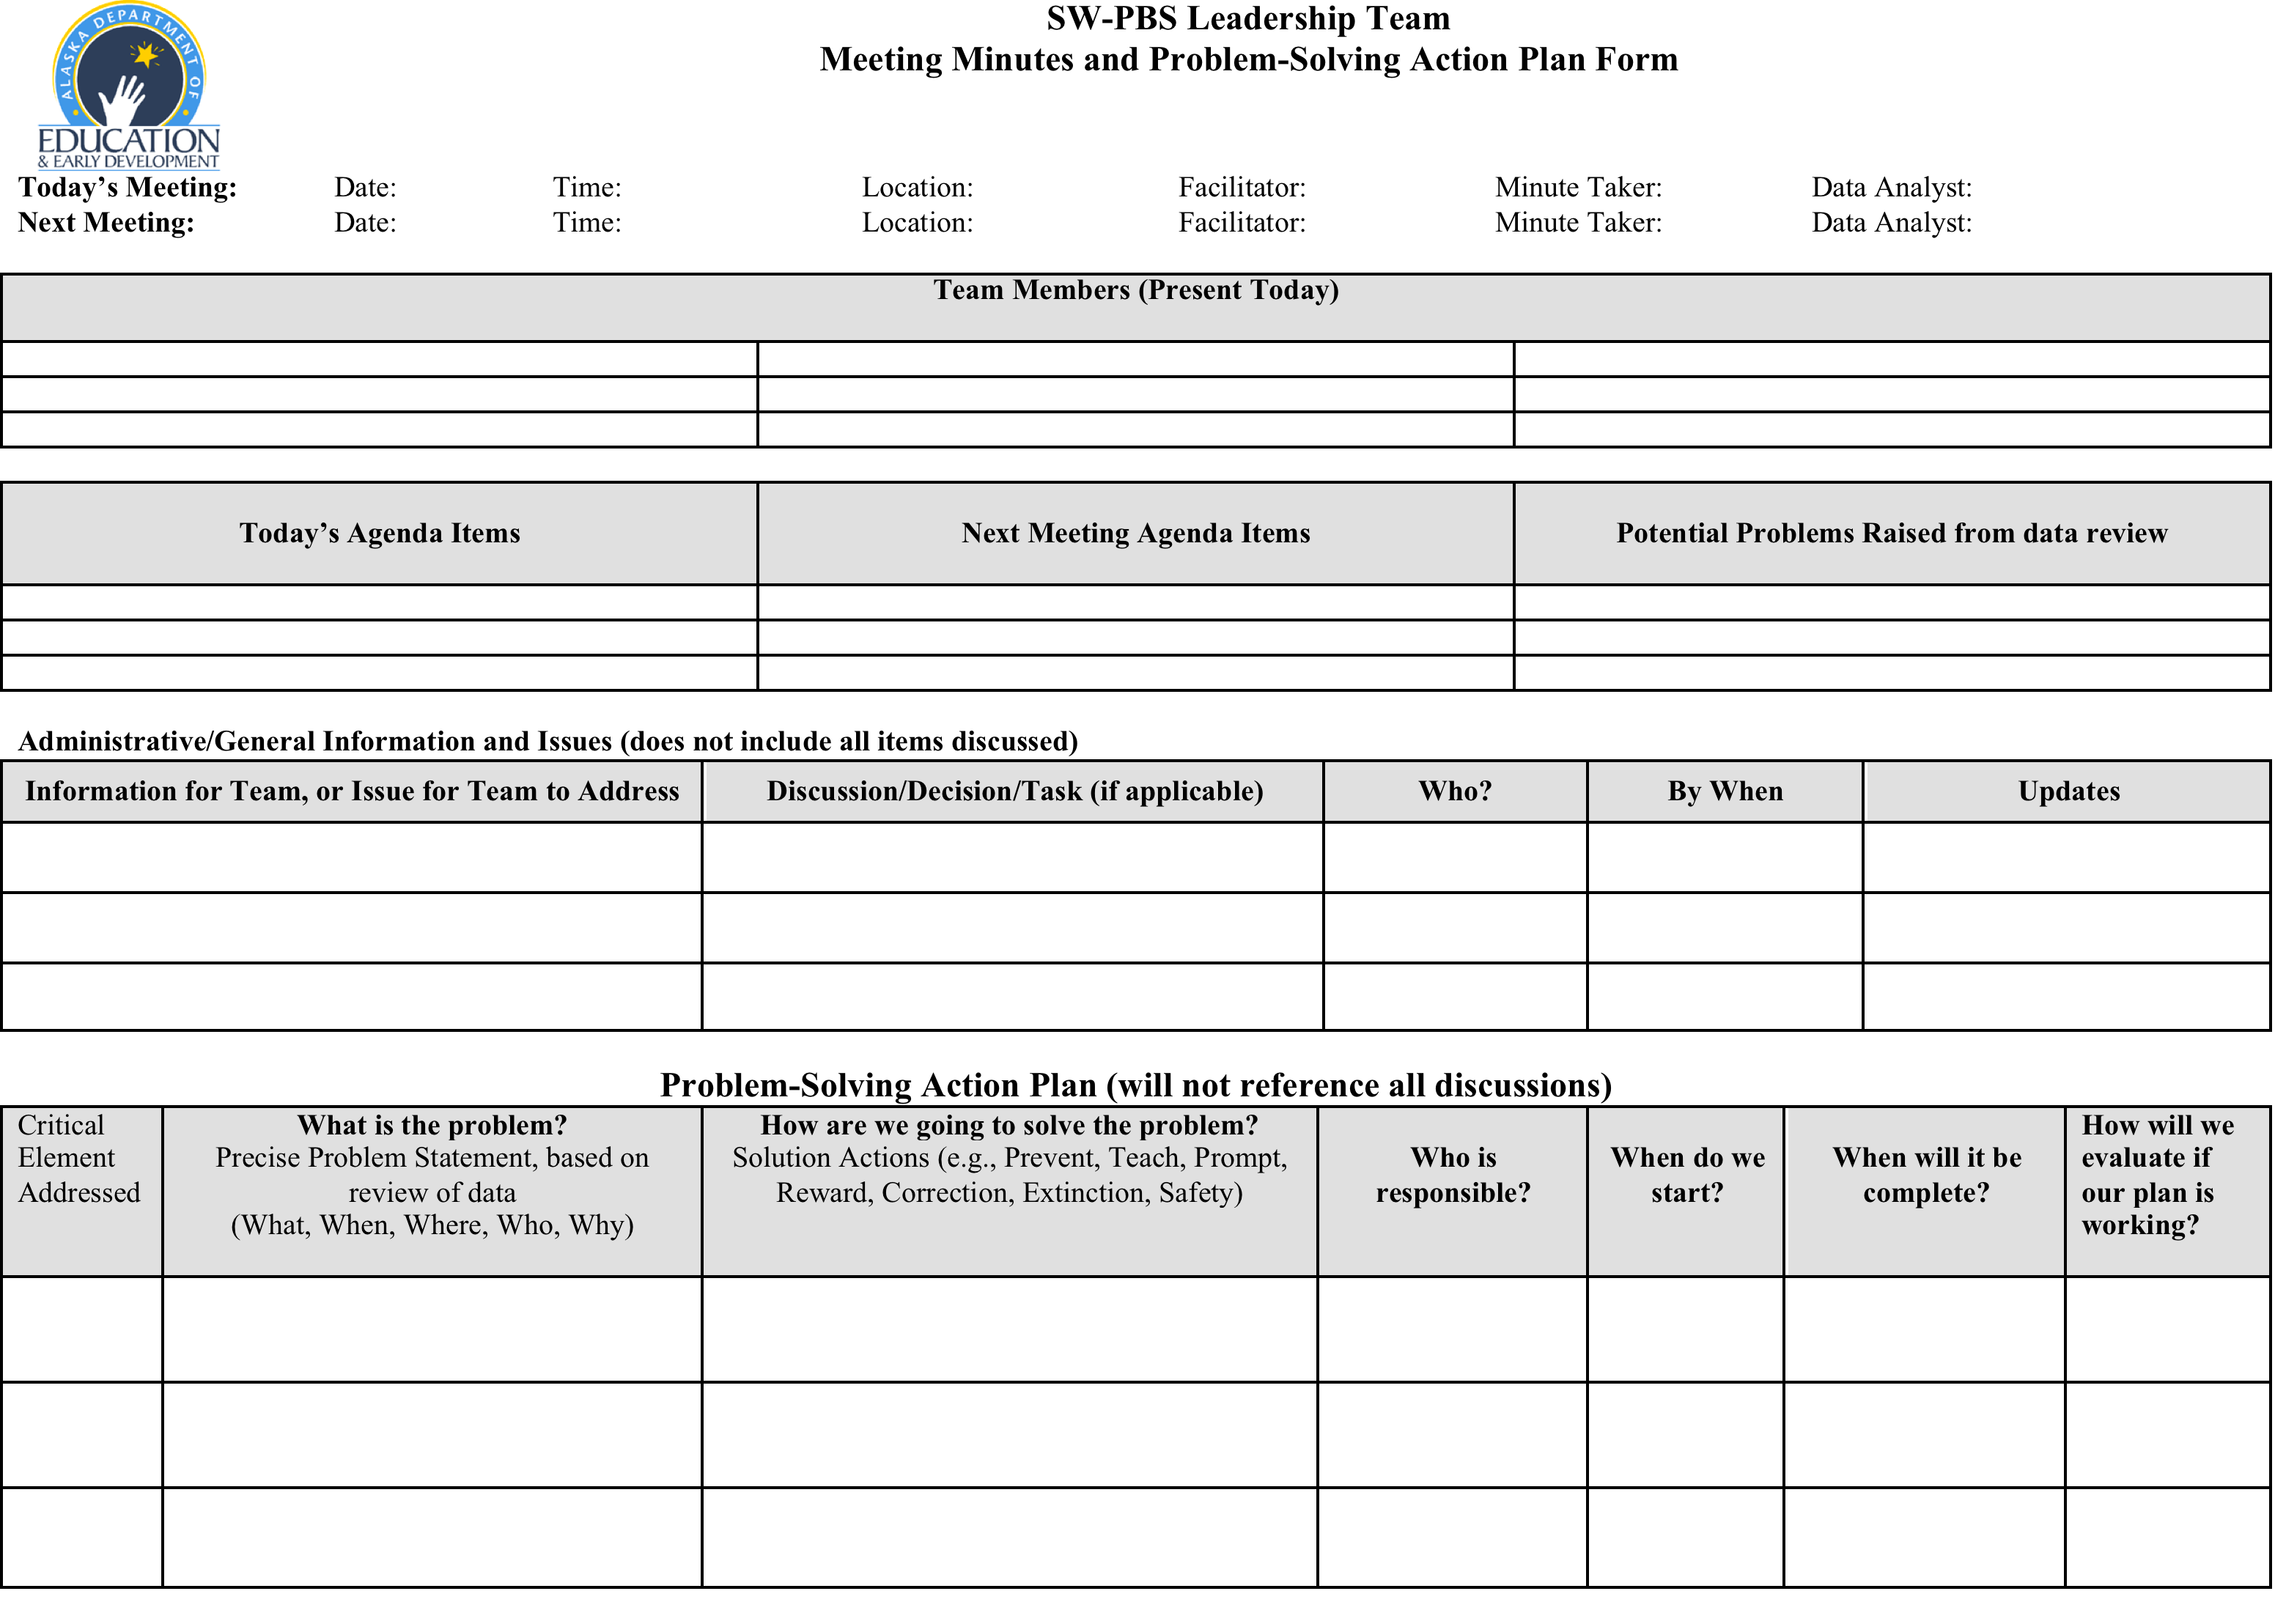

Slide 41
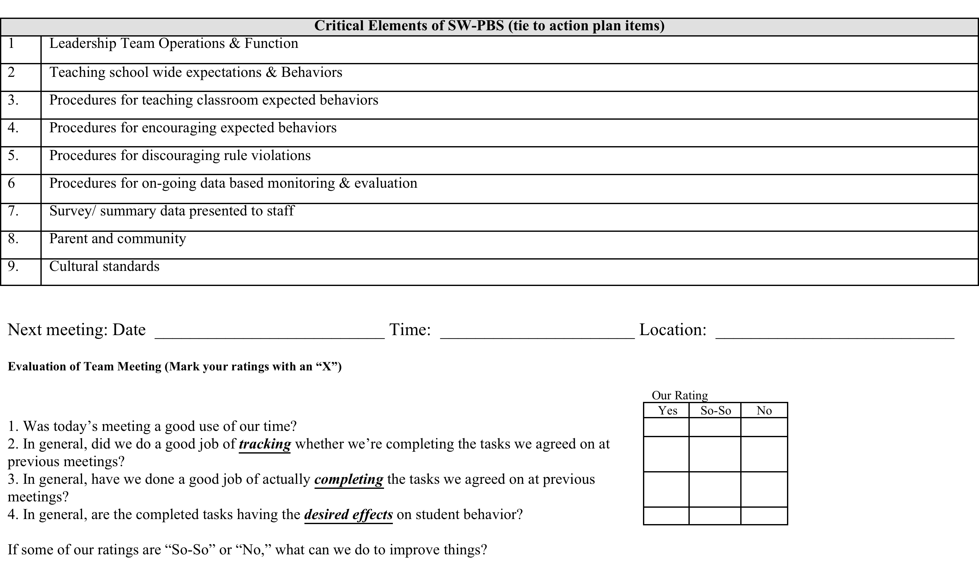

Slide 42
Administration’s Roles and Responsibilities
ALL administrators are encouraged to participate in the process.
Administrator should play an active role in the school-wide PBIS change process.
Administrators should actively communicate their commitment to the process.
Administrator should be familiar with school’s current data and reporting system.
If a principal is not committed to the change process, it is unwise to move forward in the process.

Slide 43
Critical Elements of the Team
Establish a team/collaboration
Faculty buy-in
Establish a data-based decision-making system
Modify discipline referral process/forms/definitions
Establish expectations & rules
Develop lesson plans & teach
Create a reward system
Refine consequences
Monitor, evaluate, and modify

Slide 44
Meeting prep………..
Room reserved/announced?
“New” items solicited and added to agenda?
Agenda produced and disseminated 24 hours previous to meeting?
Data reports generated and available for meeting?
Team members have individual SW- PBS Notebooks to bring to meeting.
Facilitator prepared to lead team through discussion of effects of action plans on “old” and “potential” problems.
Technology ready? Computer; internet access to SWIS assured, teleconference or videoconference ready, LCD projector set up to project data (or team has some other strategy for ensuring team members can review data at meeting).

Slide 45
What needs to be documented
Meeting demographics
  Date, time, who is present, who is absent
  Agenda
  Next meeting date/time/location/roles
Administrative/ general Information/planning items
  Topic of discussion, decisions made, who will do what, by when
Problem-Solving items
  Problem statement, determined solutions, who will do what by when, goal, how/how often will progress toward goal be measured, how/how often will fidelity of implementation be measured.

Slide 46
Benefits of Meeting Minutes
Documentation of
  Logistics of meeting (date, time, location, roles)
  Agenda items for today’s meeting ( and next meeting)
  Discussion items, decisions made, tasks and timelines assigned
  Problem statements, solutions/decisions/tasks, people assigned to implement with timelines assigned, and an evaluation plan to determine the effect on student behavior
Reviewing Meeting minutes
  An effective strategy for getting a snapshot of what happened at the previous meeting and what needs to be reviewed during the upcoming meeting
    What was the issue/problem?, What were we going to do?, Who was going to do it and by When?, and How are we measuring progress toward the goal?
Visual tracking of focus topics during and after meetings
  Prevents side conversations
  Prevents repetition
  Encourages completion of tasks
Other things to consider:
  Organizes/records your SW PBS process
  Keep a record of what has been completed
  Keep a record of what needs to be addressed

Slide 47
Review of Relevant Data for Action Planning

Slide 48
School System Data
From pbisassessment
www.pbisassessment.org

Slide 49
Scheduling of data
Group Activity: complete the data collection schedule located in your Leadership Team notebook.

Slide 50
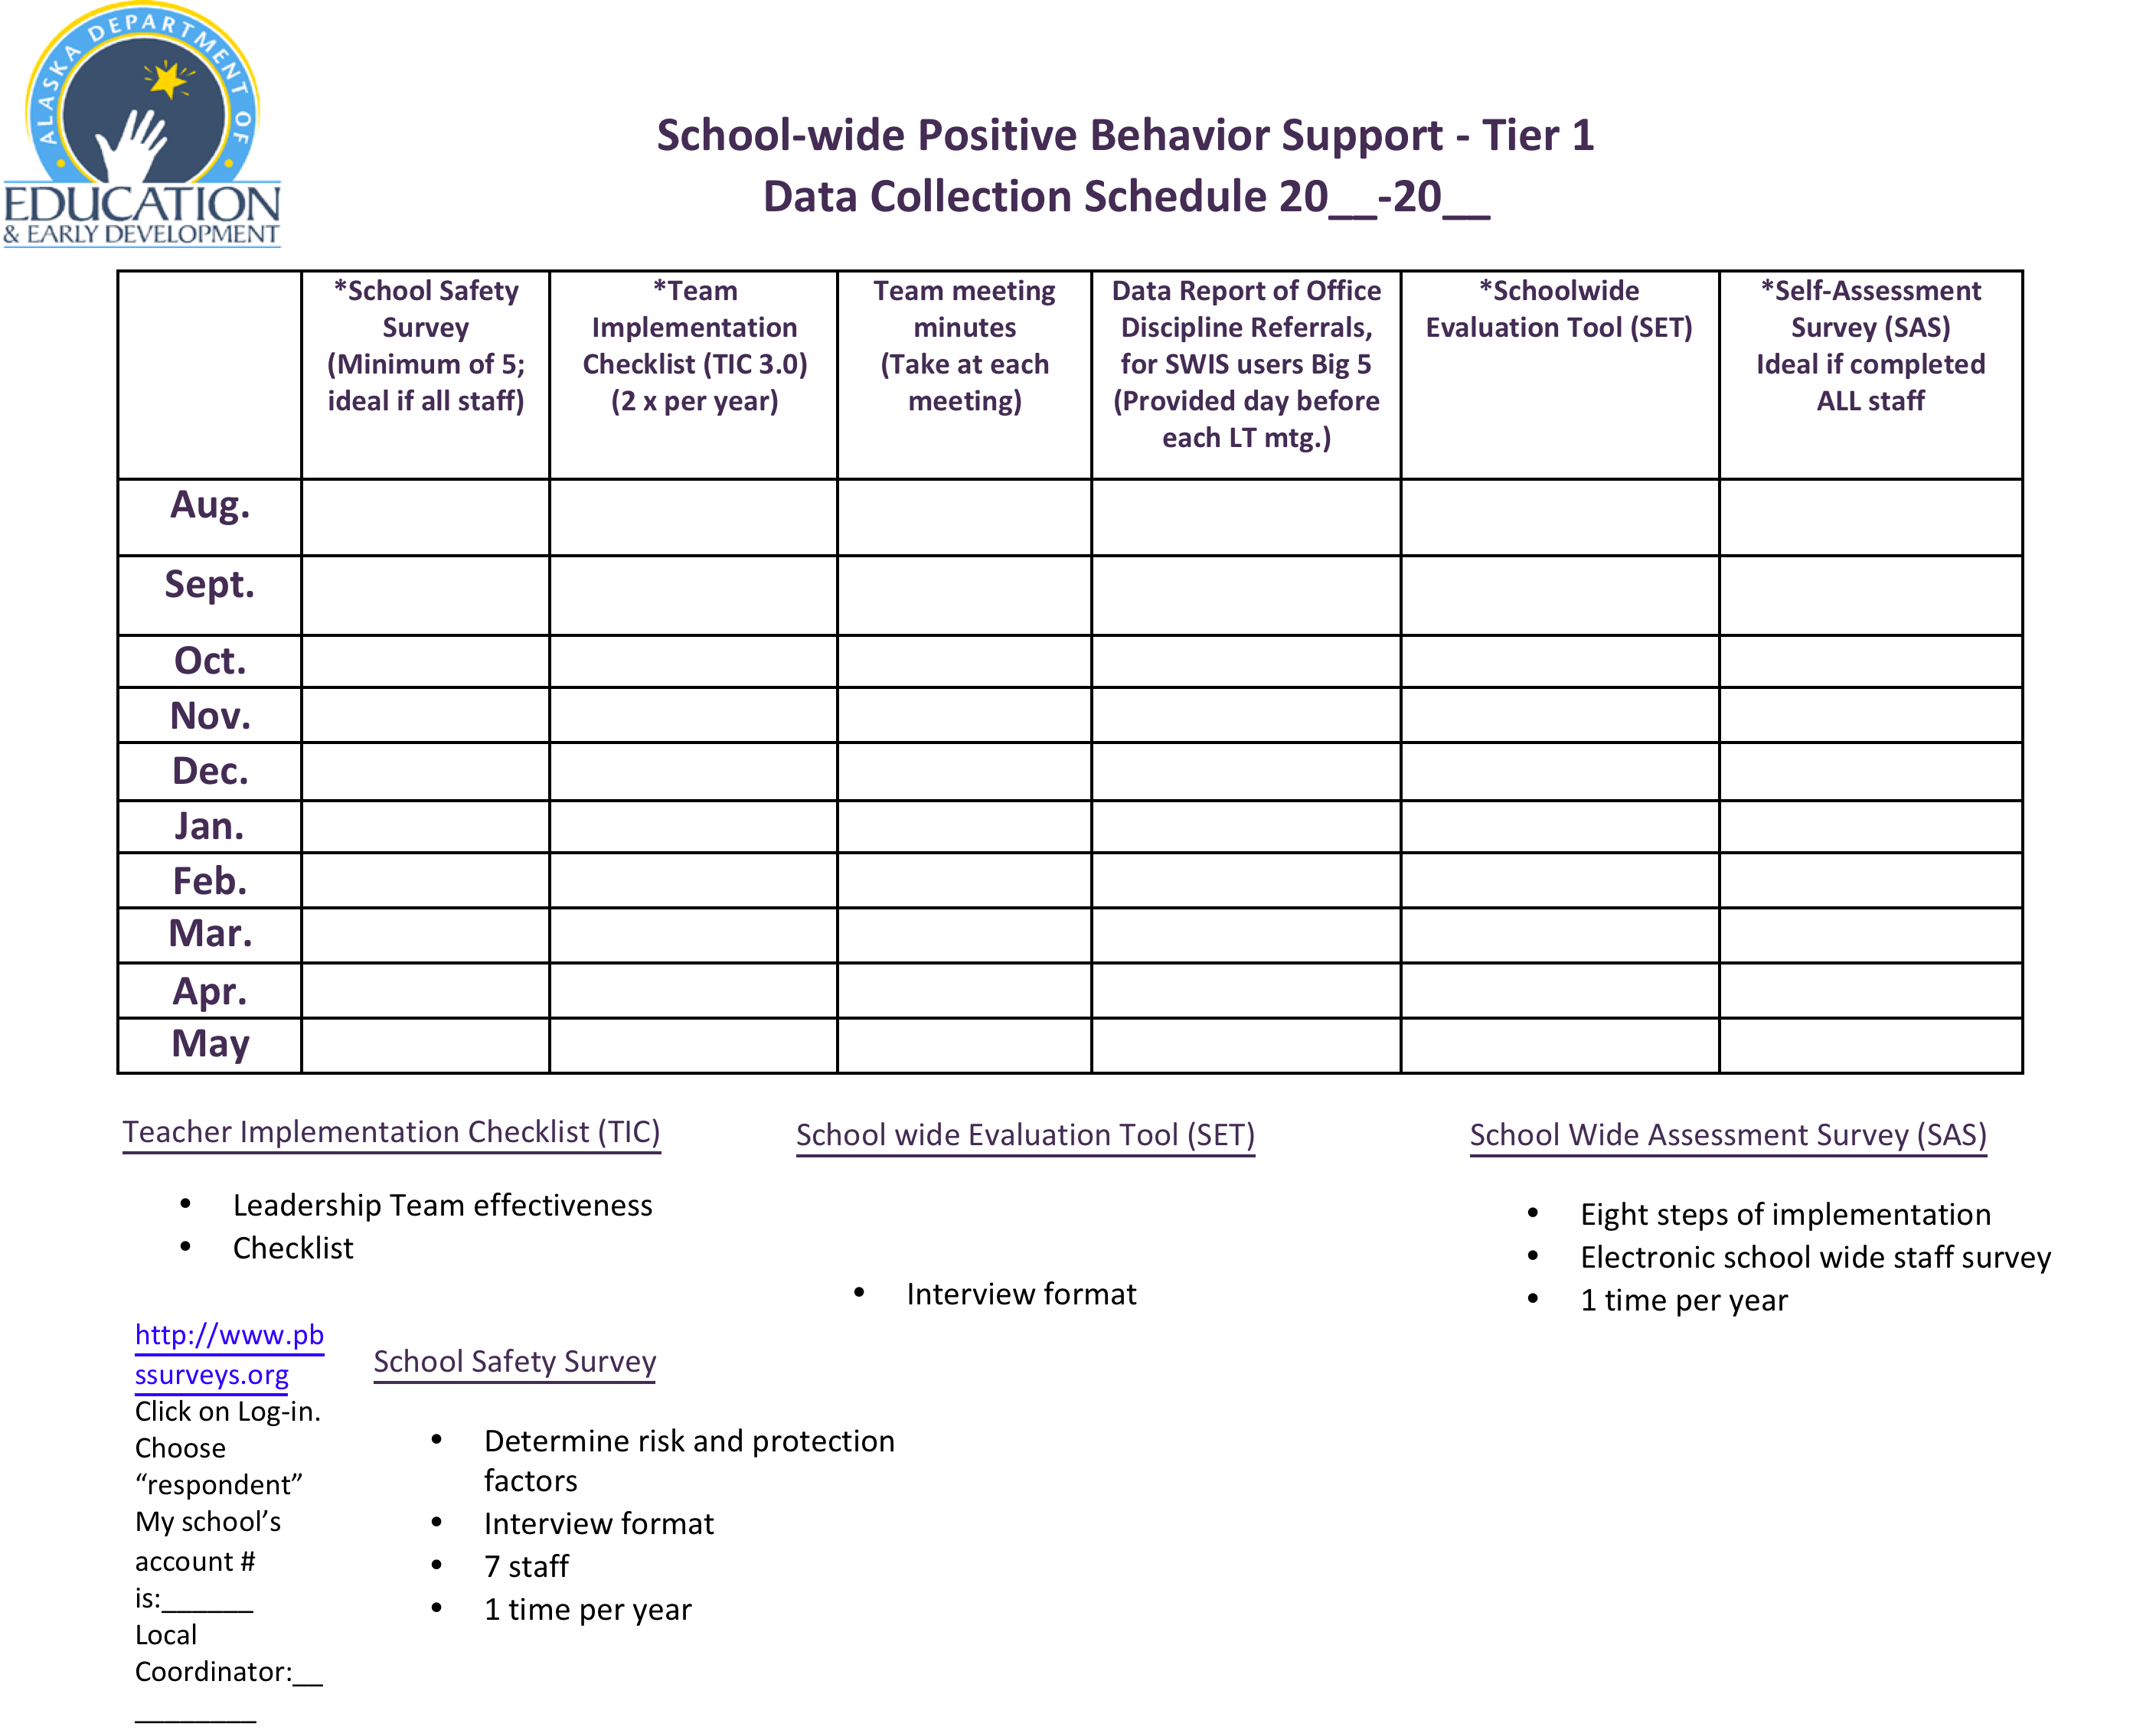

Slide 51
Review of relevant student data from SWIS & pbisassessment
Big “5” graphs
www.swis.org

Slide 52
Data based decision-making
Insert your Office Discipline Referral data here.
Notes:
Behavior matrix (majors)

Slide 53
Data base decision-making
Insert www.pbisassessment data here

Slide 54
www.pbisassessment.org
Schoolwide Assessment Survey

Slide 55
Action Planning
Activity: determine of here is a problem based on the data. If the Leadership Team determines a problem exists write one “Action Plan” item for a possible intervention or to gain more information.

Slide 56
Action planning for full implementation of “8 Steps of Implementation” for Tier 1?
The Roll Out Checklist includes:
  Teacher trainings
  Teaching students
  Administering rewards
  Booster training sessions

Slide 57
Presentation prepared by:
Lori Roth, MEd.
Education Consultation Services of Alaska
lroth507@gmail.com

