Slide 1

Positive Behavior Interventions & Supports
Framework Development
Work session: Day 2

Slide 2
Day 2
Participants will:
Learn about the component of writing SW-PBIS classroom rules
Write a reward system for non-structures settings in their school
Learn about the components of a school wide violation system
Learn about data based decision-making

Slide 3

www.pbis.org
Notes:
Sharon

Slide 4


A Continuum of Support for All
Academic Systems
Behavioral Systems
Tier Three
Individual Students
Assessment-based
Intense, durable procedures
Tier Three
Individual Students
Assessment-based
High Intensity
Tier Two
Some students (at-risk)
High efficiency
Rapid response
Tier Two
Some students (at-risk)
High efficiency
Rapid response
Tier One
All settings, all students
Preventive, proactive
Tier One
All students
Preventive, proactive
Notes:
Another important concept for you to understand is that SWPBS is a continuum of Support for All.
This triangle represents all students in your school. All schools have a continuum of Academic Systems (on the left) and Behavioral Systems (on the right). The Academic Continuum is referred to as Response to Intervention and SWPBS is the Behavioral Systems.
Starting at the bottom of the triangle, in the green are the Tier One Interventions that we provide to all students in all settings. One the academic side, this is all the instruction we provide to the students in our classes and on the behavior side it involved the preventive procedures like hallway expectations, procedures for lunch dismissal and our on-time to class policies. These are effective for about 80% of our students.
Some students who are at-risk need more intensive or different responses (a different dose) in Tier 2. Academically these are kids we help in support centers or provide tutoring. Behaviorally, we may provide targeted social skills instruction or mentors to help them be socially successful in school. We typically serve about 15% of students.
The students at the top of the triangle are our students who require Tier Three interventions. These are individualized, based on specialized assessments and intense in nature. These students at the top of the triangle take more time, energy and resources.
This year, we are focusing on Tier One interventions. We are building our triangle, if you will.

Slide 5
Allocated Time
Teacher
Time
Student
Time
Engaged Time
Academic
Engaged
Time
Notes:
Points to cover:
Academic engaged time is the smallest amount of time, but is the time when there are the least amount of behaviors.

Slide 6
Did you know?
School-wide Positive Behavior Support is a district or school’s process for teaching expected social and behavioral skills so the focus can be on teaching and learning.

Slide 7
Implementation Steps: Step 5 of “8 Steps”
Establish a school-level PBIS Leadership Team
School-behavior purpose statement
Set of positive expectations and behaviors.
Procedures for teaching school-wide expected behaviors
Procedures for teaching classroom wide expected behaviors.
Continuum of procedures for encouraging expected behaviors.
Continuum of procedures for discouraging rule violations.
Procedures for on-going data-based monitoring and evaluation.

Slide 8
Why Focus on Classroom Rules?
A dependable system of rules and procedures provides structure for students and helps them be engaged with instructional tasks
Teaching rules and routines to students at the beginning of the year and enforcing them consistently across time increases student academic achievement and task engagement (Evertson & Emer, 1982; Johnson, Stoner & Green, 1996)
Clearly stating expectations and consistently supporting them lends credibility to a teacher’s authority (Good & Brophy, 2000)

Slide 9
What are Expectations and Rules?
Expectations are outcomes
Rules are the specific criteria for meeting expectation outcomes
Rules identify and define concepts of acceptable behavior
Use of expectations and rules provides a guideline for students to monitor their own behavior and they remind and motivate students to meet certain standards
Notes:
To correctly establish classroom rules we need to understand some specific vocabulary.
Although they are associated, expectations and rules are not the same.
Expectations are the outcomes we want to get. For example, we want students to be Safe, to be Respectful, to be a Learner, to be Responsible. These are expectations or outcomes.
Rules are how we get to those outcomes. Rules are specific, they define what we want students TO DO and they provide a consistent guideline for how to meet the standards of our expectations.
You have already identified the expectations for your school. You have used those expectations to create rules for non-classroom settings- these are on your matrix. Our focus today is using school wide expectations to identify individual classroom rules.
For example, what does it mean to be Safe in Mrs. Anderson’s kindergarten classroom? Or what does it mean to be Respectful in Mr. Smith’s PE class?
Again, expectations are the outcomes we want for students and you’ve already identified those on your matrix. Rules are the specific criteria for meeting those expectations in each classroom within your building.
(Newcomer, 2008)

Slide 10
Guidelines for Writing Classroom Rules
Consistent with school-wide expectations/rules
Observable
Measureable
Positively stated
Understandable
Always applicable – Something the teacher will consistently enforce

Slide 11
Other Considerations…
Students play a role in formulating rules
Rules displayed prominently; easily seen
Teacher models and reinforces consistently
Rules that are easily monitored
Notes:
Other ideas to consider…
Students should be given an opportunity for input about classroom rules. This increases the likelihood they will know and follow the rules.
Classroom rules should be posted so they are easily seen. This serves as a reminder to students AND increases the likelihood teachers will teach, model, refer to and reinforce the rules.
Rules should be manageable and not require excessive time to hold students accountable.

Slide 12
Expectations and Rules
Example…
Expectation is: Students will be Safe
Rules are…
    Keep hands and feet to self
    Use materials correctly

Slide 13
Classroom rule writing activity
List problem behaviors in your classroom
List replacement behavior (what we want kids to do instead)
List school wide expectations
Categorize rules within school wide expectations
*Post, teach and acknowledge
student compliance of rules

Slide 14
Did you know……
Behavior is Learned.
Students Do Not Learn Through the Sole Use of “Get Tough”, “Aversive” Consequences.
We Should:
    Teach Social Skills Directly and
    Give Positive Feedback About What They are Doing Correctly or Appropriately.

Slide 15
Classroom Rules/Expectations
Classroom-wide positive rules/expectations are taught and encouraged
Teaching classroom routines are taught and encouraged
Ratio of 6-8 positive to 1 negative adult interaction
Active supervision
Redirection for minor, infrequent behaviors
Pre-correction for chronic errors
Effective academic instruction and curriculum

Slide 16
Schedule for teaching Classroom Rules
First Grading Period
  Teach rules for all areas of school, including individual classrooms, during first week of school
  After first week, review rules 2 or 3 times / week
Second Grading Period
  Review rules once per week
Remainder of the Year
  Review rules periodically as needed

Slide 17
PBIS.org

Slide 18
Implementation Steps: Step 6 of “8 Steps”
Establish a school-level PBIS Leadership Team
School-behavior purpose statement
Set of positive expectations and behaviors.
Procedures for teaching school-wide expected behaviors
Procedures for teaching classroom wide expected behaviors.
Continuum of procedures for encouraging expected behaviors.
Continuum of procedures for discouraging rule violations.
Procedures for on-going data-based monitoring and evaluation.
Notes:
School wide reward system for reinforcing the use of desired social behaviors

Slide 19
What do we know…
Rewards are effective when used:
  To build new skills or sustain desired skills, with
  contingent delivery of rewards for specific behavior, and
  gradually faded over time.
        Akin-Little, Eckert, Lovett, Little, 2004
“For high-interest tasks, verbal rewards are found to increase free choice and task interest. This finding replicates”
        Cameron and Pierce, 1994; Deci et al., 1999).
“When tasks … are of low initial interest, rewards increase free-choice, and intrinsic motivation…”
        Cameron, Banko & Pierce, 2001 p.21

Slide 20
School wide formal recognition….
Rewards that are more public in presentation
More distant in time from demonstration of behavior and presentation of reward
Criteria definition
  Who is eligible, how often award is delivered, how many students receive award
  Should be implemented consistently
  Strict criteria are needed for more public awards (student of month) Looser criteria for awards distributed at higher rate (recess tickets)
Presentation
  Location and form in which award is presented (School assembly, classroom, privately)
Dissemination
  Bulletin boards, newsletters, parent letters

Slide 21
Example #1
Criteria
  Satisfactory grades
  Follow school rules
  No discipline referrals
  Class work completed
  Five staff signatures (for example, teacher, teaching assistant)
  Students listed in office for all staff to review
Presentation
  Monthly award assembly
Presentation
  Monthly award assembly
Award
  Button
  Privileges
    In hallways without pass
    Early lunch
    Self-manager lunch table
    Early release (1-2 min. max) from class when appropriate
Dissemination
  Honor list in classroom
  Parent notes

Slide 22
Encourage Expected Behaviors
Schools should teach, support, and encourage students to be “self-managers”
Student should not “depend” on rewards to behave well. Rewards are effective when
  Tied to specific behaviors
  Delivered soon after the behavior
  Age appropriate (actually valued by student)
  Delivered frequently
  Gradually faded away

Slide 23
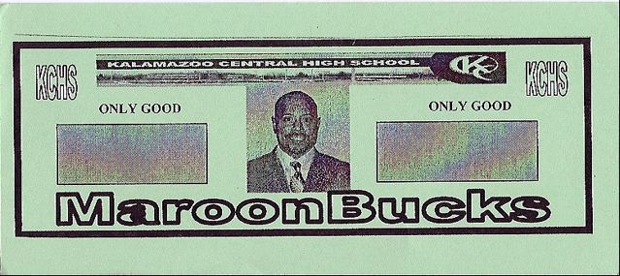
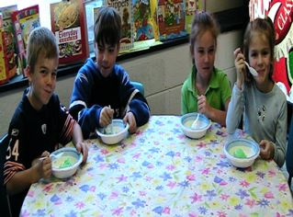
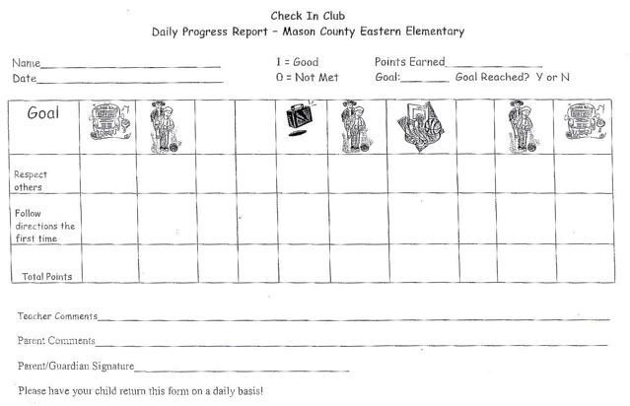
Types of reward systems
School-wide
Classroom
Individual
Notes:
School-wide: Tied into school expectations(ticket system)
Most students will....
What happens after the behavior. By definition a consequence either increases (REINFORCEMENT) or decreases the probability the behavior will recur in the future (PUNISHMENT)
Because this happens...

Slide 24
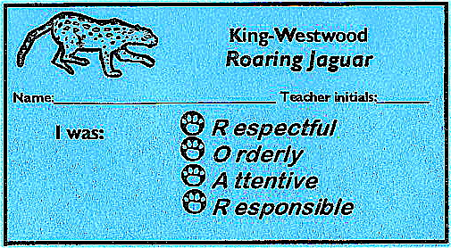


Many schools use a ticket system
Tied into school expectations
Specific feedback on student’s behavior
Provides visible acknowledge of appropriate behavior for student
Helps to remind staff to provide acknowledgements
Jose R.
L.M.

Kalamazoo Central High School

Slide 25
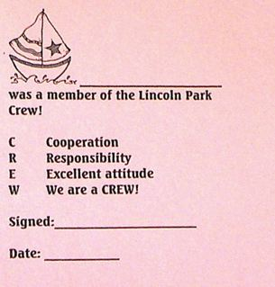
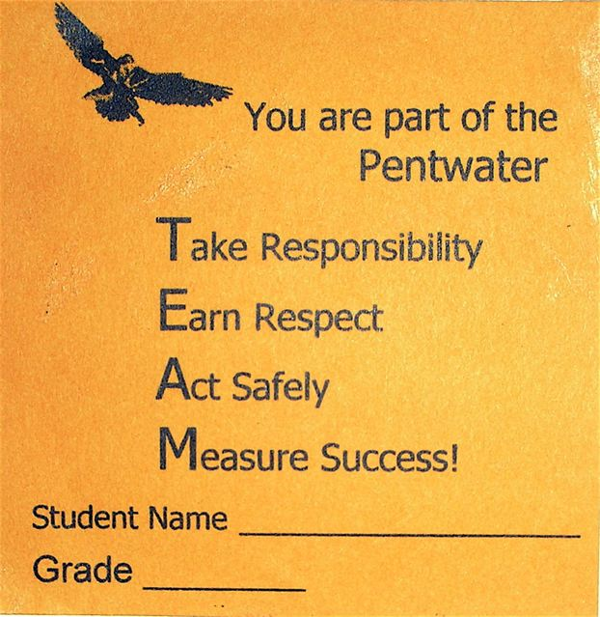
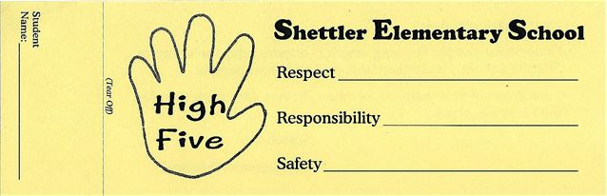
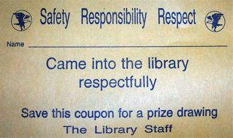
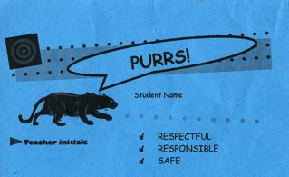

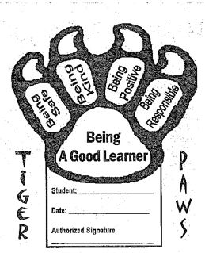

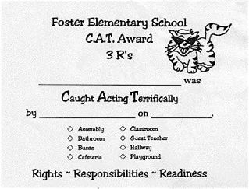
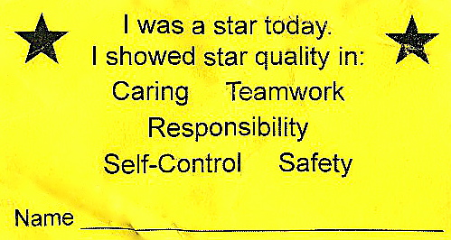
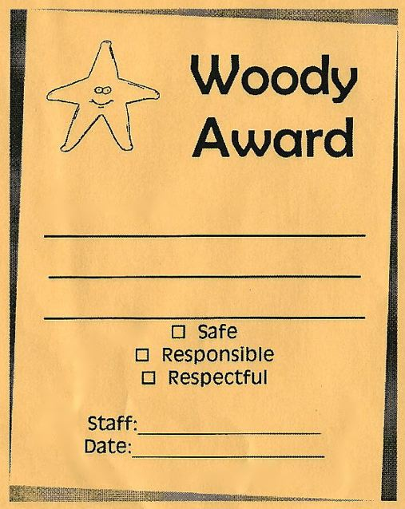
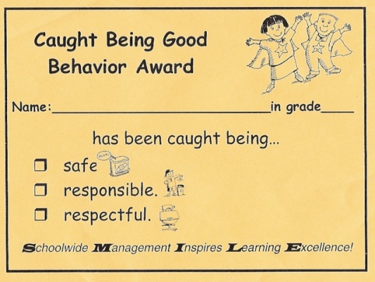
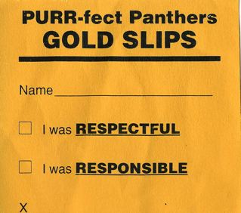
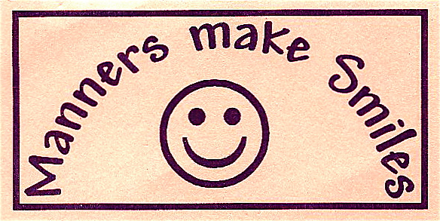
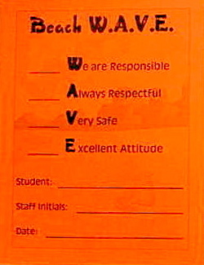
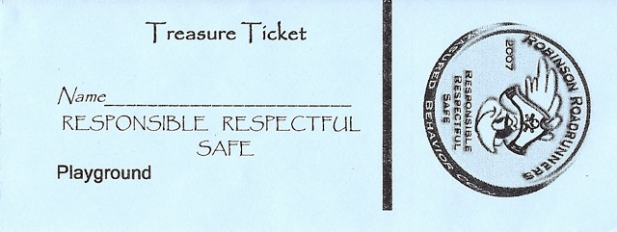
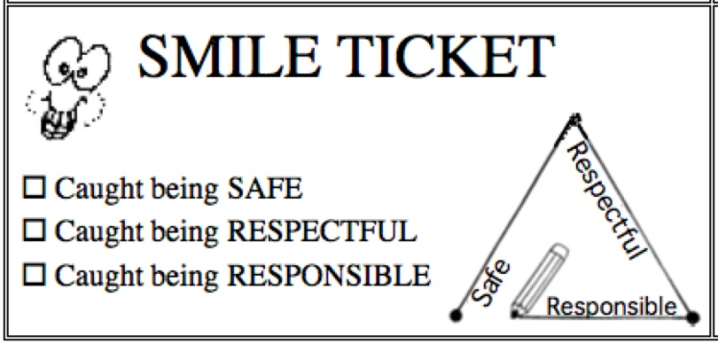
Schoolwide “quick” acknowledgements
Rewards that are quickly presented in the presence of the behavior

Slide 26
Work session 1 overview
Staff will complete a reward system inventory for each building.
Staff will develop the framework for a school wide reward system.
Notes:
Use activity Sheets

Slide 27
Implementation Steps: 7 of “8 Steps”
Establish a school-level PBIS Leadership Team
School-behavior purpose statement
Set of positive expectations and behaviors.
Procedures for teaching school-wide expected behaviors
Procedures for teaching classroom wide expected behaviors.
Continuum of procedures for encouraging expected behaviors.
Continuum of procedures for discouraging rule violations.
Procedures for on-going data-based monitoring and evaluation.
Notes:
School wide reward system for reinforcing the use of desired social behaviors

Slide 28
Violation System
Behaviors are operationally defined.
  Major Behaviors: Discipline incidents that must be handled by the administration.
  Minor Behaviors: Discipline incidents that are handled by the classroom teacher and usually do not warrant a discipline referral to the office.
The data should be very easy to collect (1% of staff time).
System in place for data entry and report generation.
System in place to collect office discipline referral data
    Office Discipline Referral Form

Slide 29
General Procedure for Dealing with Problem Behaviors
Observe problem
behavior
Find a place to talk with student(s)
Is
behavior
major?
NO
YES
Ensure safety
Problem solve
Write referral &
Escort student to office
Determine
consequence
Problem solve
Determine
consequence
Follow procedure
documented
Follow
documented
procedure
NO
Does
student
have 3?
YES
Follow
through with
consequences
File necessary
documentation
Send
referral to
office
File necessary
documentation
Follow up
with student
within a
week
Taken from SWIS.org demo

Slide 30
Why Operationally defined?
One problem behavior cannot fit into more than one definition.
Define so all staff can learn to identify the same behaviors.
What one teacher may consider disrespectful, may not be disrespectful to another teacher. For that reason, problem behaviors must be operationally defined.

Slide 31
Is this operationally defined?
Disruption: student engages in behavior causing an interruption in a class or activity. Disruption includes: sustained loud talk, yelling, or screaming; noise with materials; horseplay or roughhousing; and/or sustained out of seat behavior.

Slide 32
Why an Office Discipline Referral Form
Ease of use
Track behaviors
Consistency across staff.
Data input

Slide 33
Sample ODR
Taken from SWIS.org demo

Slide 34
Violation Procedure
Introduce District Violation System

Slide 35
Insert District ODR

Slide 36
Insert District Flow Chart

Slide 37
Review District Operationally defined Definitions with Staff
Major
Minor

Slide 38
Implementation Steps: 8 of “8 Steps”
Establish a school-level PBIS Leadership Team
School-behavior purpose statement
Set of positive expectations and behaviors.
Procedures for teaching school-wide expected behaviors
Procedures for teaching classroom wide expected behaviors.
Continuum of procedures for encouraging expected behaviors.
Continuum of procedures for discouraging rule violations.
Procedures for on-going data-based monitoring and evaluation.
Notes:
School wide Information System

Slide 39
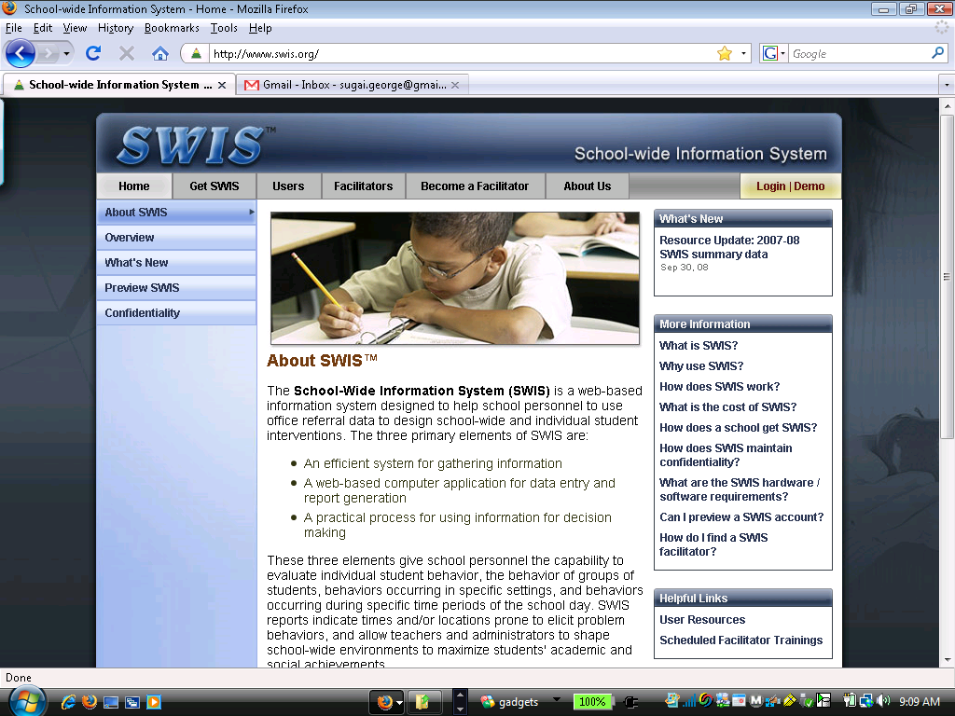
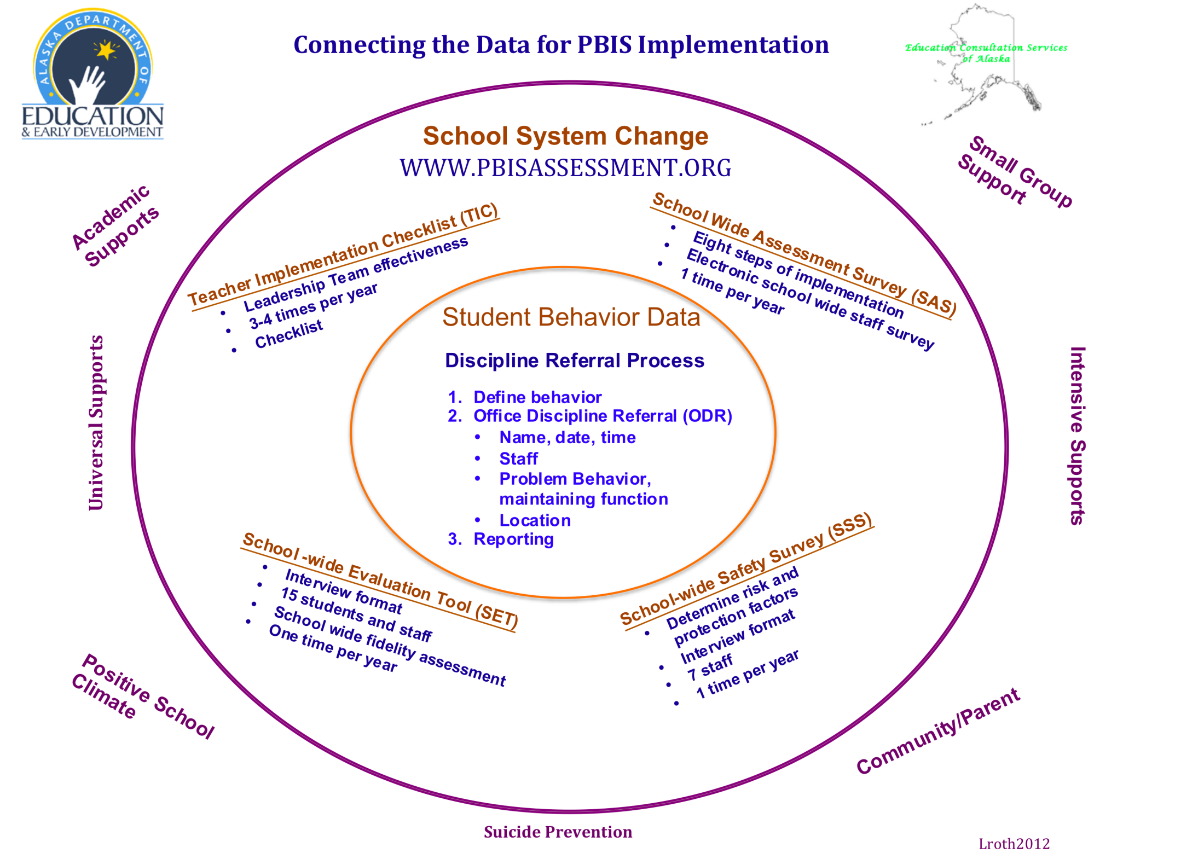
www.swis.org
You are here

Slide 40
DATA
Target data/data collection strategies that will serve several functions
Student (office Discipline Referral Form)
    What supports do students need?
    Are behaviors improving?
Staff (www.pbisassessment.org)
    What supports do staff need?
System (www.pbisassessment.org)
    Are there break-downs (fidelity) in implementation?
    Guide resource allocation - District/ School
    Visibility / Political support
Notes:
Lori

Slide 41
Data based decision-making logic
Establish Ground Rules
Start with Data
Match Practices to Data
Align Resources to Implement Practices
Notes:
Establish ground rules
Nothing sacred / Everything is important
Not about “philosophy” or “theory"
Keep focus on outcomes
Remember, if what we are doing now was meeting the needs of all students we wouldn’t be having the conversation
Allow for a transition period (Phase of Implementation) 2-3 years
Start with Data
Be prepared for the “examination & explanation”
Understand that data are simply a “sample” of what is going on
Data must be contextualized
Don’t drown in the data
Assess the integrity of the data (plan to correct)
Keep the conversation focused on data that are “in your control”
Be prepared with a draft action plan
Match Practices to Data
Strategies, curricula, and resources independent of what is currently in place
Don’t limit to what you currently know – outside resources
Build your daily schedule around priorities
Align Resources to Implement Practices
New roles to reach outcomes will require training and on-going technical assistance (systems)

Slide 42
Data-Based Decision Making
Determine what questions you want to answer.
Determine what data will help to answer questions.
Determine the simplest way to get data.
Put system in place to collect data.
Analyze data to answer questions.
Focus on both Academic and Social Outcomes

Slide 43
Why Collect Discipline Information?
Decision making.
Professional Accountability.
Decisions made with data (information) are more likely to be (a) implemented, and (b) effective.
Notes:
Not enough time to collect all the things students do right.

Slide 44
Data Base Development
Choose
Data Based
Format.
Review Student Handbook for Major/Minor Behaviors
Define Behaviors
Create Spreadsheet with required Data Points or prepare License Agreement.
Train Staff
in Data Entry.
Review ODR for Data Points.

Slide 45
District Data Systems Should
Report on discipline
Could be a web-based data collection system
Real-time data
Local control
Have the ability to generate graphics for decision-making
Confidential and secure
Adapted from SWIS.org

Slide 46
Data based Decision Making Reports
Major data points (required)
Student name
Date
Location of behavior
Time of behavior
Type of behavior
Adapted from www.swis.org
Notes:
Major behaviors defined as those needing administrative interventions
Minor behaviors dealt with through classroom management plan.

Slide 47
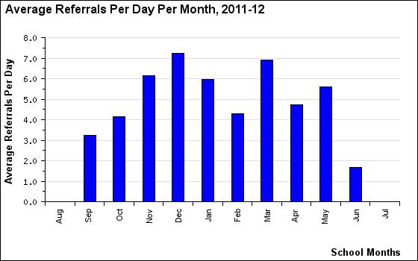
Taken from SWIS.org demo

Slide 48
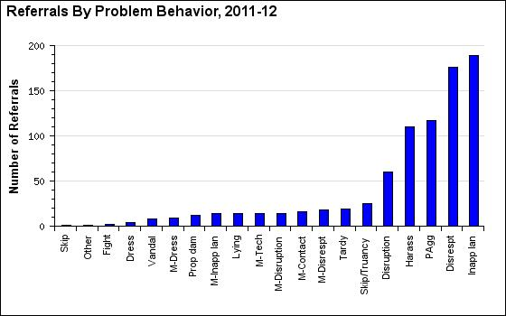
Taken from SWIS.org demo

Slide 49
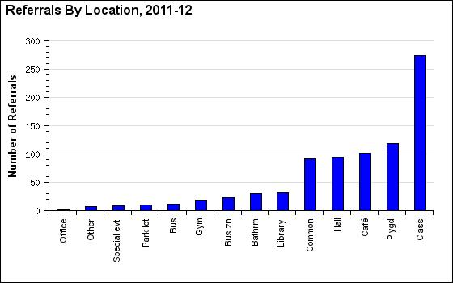
Taken from SWIS.org demo

Slide 50
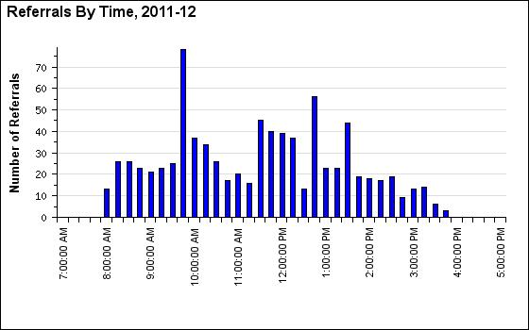
Taken from SWIS.org demo

Slide 51
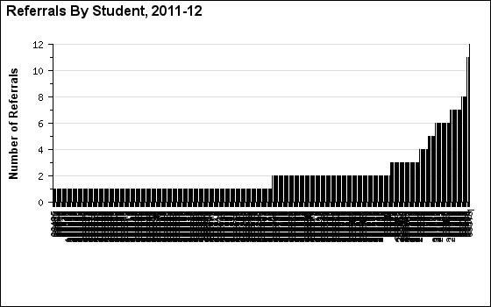
Taken from SWIS.org demo

Slide 52
Our Goal:
Decision-Making System
What do you want the data to tell you?
  School-wide
  Individual student
Adapted from www.swis.org
Notes:
lori

Slide 53
Decision making questions to consider
Is there a problem?
What areas/systems are involved?
Are there many students or few involved?
What kind of problem behaviors are occurring?
When are these behaviors most likely?
What is the most effective use of our resources to address the problem?
Possible “function” of problem behavior?
Who needs targeted or intensive academic supports?
What environmental changes/supports are needed?

Slide 54
Sample Decision Rules
If……… | Then
More than 35% of students received one or more office discipline referrals There are more than 2.5 office discipline referrals per student | School-wide System
More than 35% of referrals come from non-classroom settings There are more than 15% of students receiving referrals from non-classroom settings | Non-Classroom Setting Specific System
More than 50% of referrals come from the classroom More than 40% of referrals come from less than 10% of classrooms | Classroom System
More than 10-15 students receive more than 10 office discipline referrals | Targeted Group Interventions
Less than 10 students receive more than 10 office discipline referrals Less than 10 students continue the same rate of referrals after receiving targeted group support A small number of students destabilize the overall functioning of school | Individual Systems with Action Team Structure
Taken from www.pbis.org

Slide 55
Presentation prepared by:
Lori Roth, MEd.
PBIS Data & Implementation Coach
Education Consultation Services of Alaska
lroth507@gmail.com
Sharon Fishel
State SW-PBS Coordinator
Alaska Department of Education & Early Development
Education Specialist II
Sharon.Fishel@alaska.gov
www.education.alaska.gov

